Slide 1
TPO Competitive Test Programs
Summary of Results

Slide 2
All testing was conducted by an independent laboratory.
Carlisle chose to utilize an independent laboratory to conduct all testing to add credibility to the study. Membrane was purchased from various sources but was always acquired through the same channel a roofing contractor would use. One roll of each competitor’s membrane was selected and various samples were cut from these rolls.

Slide 3
The Tests
Seam Strength
Flexibility
Weldability
Breaking Strength
Tearing Strength
Thickness Over Scrim
Puncture Resistance
Chemical Analysis
Heat Aging @ 240°F
This list represents the actual physical properties that were evaluated. Each of these physical properties affects the service life of the roofing system in some way.

Slide 4
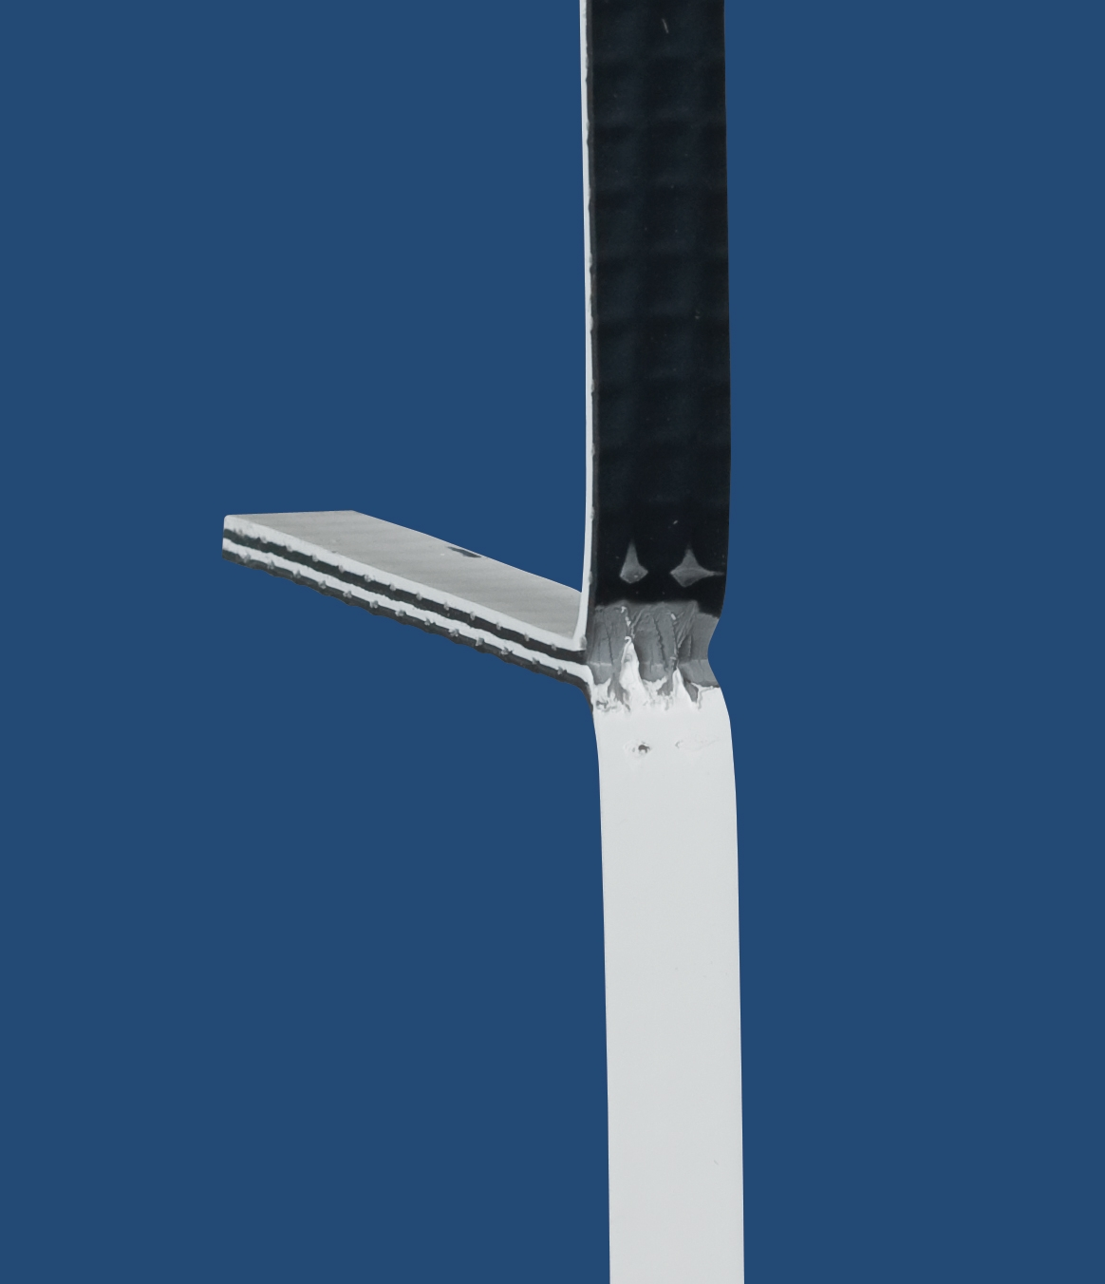
Seam Strength
Seam Peel Strength Test
Notes:
The test is actually conducted as depicted here and puts the sample in peel
The failure mode will typically be either the membrane breaking outside of the weld area or the plies delaminating from the scrim
The weld itself will not fail since (like a metal to metal weld) the weld is stronger than the membrane itself

Slide 5
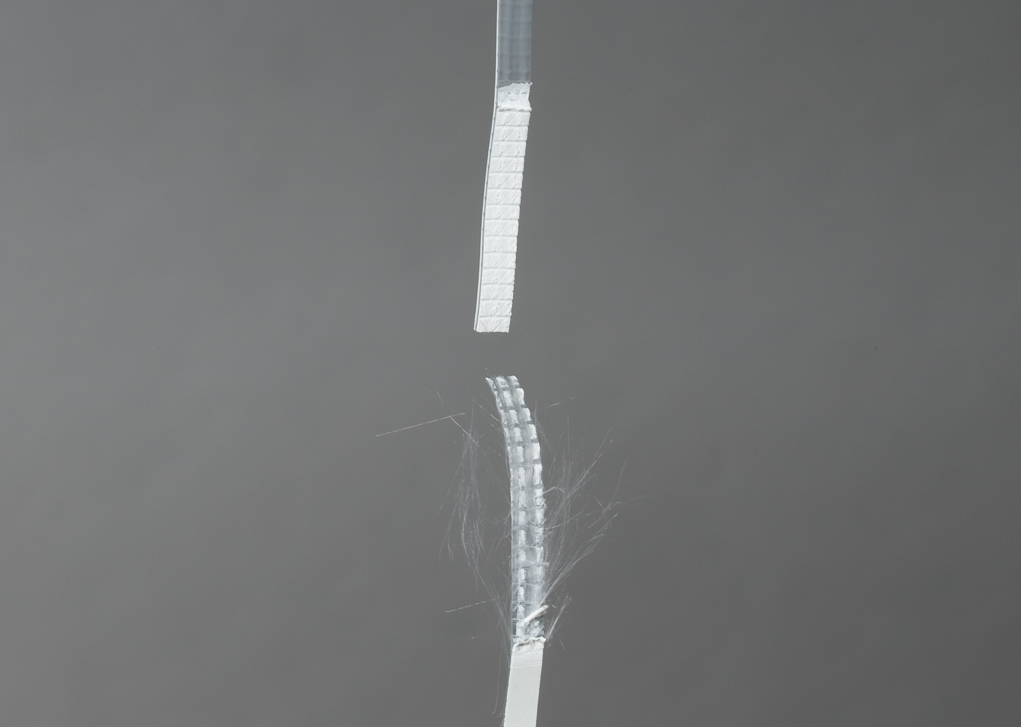
Seam Strength
Desired Mode of Failure During Seam Peel Strength Test – Ply-to-Ply Separation

Slide 6
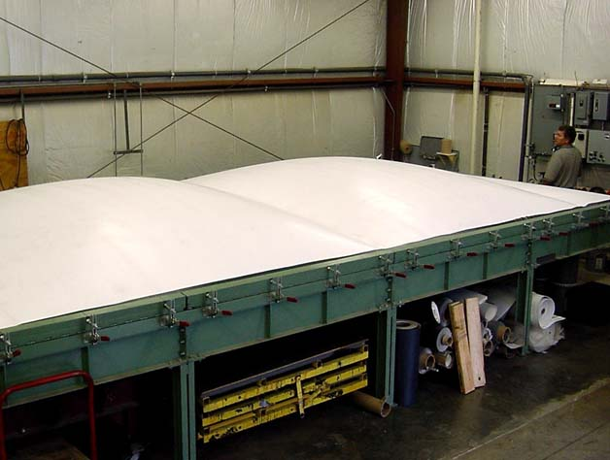
Seam Strength
Simulated Wind Uplift Test - The stronger the seam, the greater the uplift resistance.

Slide 7
Seam Strength
A chain is only as strong as its weakest link. It is extremely important that the seam of a TPO roofing system does not become that weak link. If welded properly the seam areas should be stronger than the sheet itself. A wide range of weldability will help ensure a solid seam at various temperatures and conditions without adjusting speeds and temperatures of the welder.

Slide 8
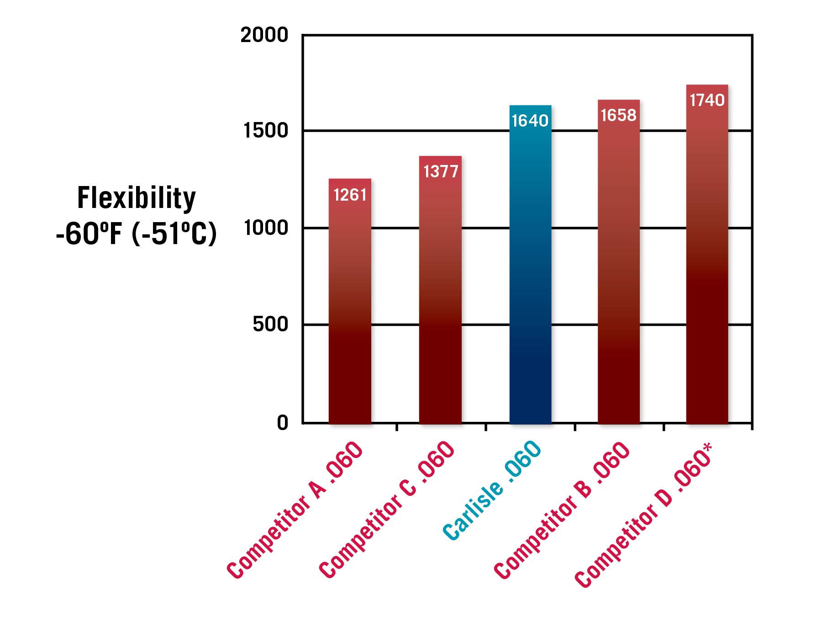
Flexibility
In a recent survey contractors listed ease of installation as the physical characteristic that they use most often to determine which membrane they prefer to install. Ease of installation is defined in part by flexibility. The more flexible the membrane, the easier it is to complete details and install the membrane.
*Competitor D is a premium-priced product compared to the other 4 samples.

Slide 9
Window of Weldability
A wide window of weldability will help ensure a solid seam is created at various ambient temperatures and weather conditions without adjusting speeds and temperatures of the welder. In addition to more consistent seaming, a wide window of weldability provides labor savings and an easier to install roofing system

Slide 10
Breaking Strength
Breaking Strength Test

Slide 12
Average Breaking Strength
A majority of TPO roofing systems that are installed are mechanically fastened to the roof deck. Breaking strength is a critical measurement of a sheet's strength if the membrane is ever subjected to extreme forces, such as excessive wind, against the fasteners that hold it in place. The ASTM breaking strength test consists of a machine pulling the membrane in opposite directions and recording the amount of force necessary to create membrane failure. This test is performed both across the sheet (cross direction) and lengthwise (machine direction). The numbers above represent the average of the machine and cross direction results.
*Competitor D is a premium-priced product compared to the other 4 samples.

Slide 13
Tearing Strength
Tearing strength is very similar to breaking strength and its importance is just as critical. Tearing strength is a measurement of how much force is required to rip the membrane from the edge, as opposed to breaking strength which involves pulling opposite ends of the sheet in different directions. Tearing strength results are also measured by adding the results of the force required to tear the sheet both across and down the sheet. The main benefit to a high tearing strength value is experienced when a small cut in the membrane occurs. By having high tearing strength a small cut is less likely to become a large tear, which can lead to excessive damage.
*Competitor D is a premium-priced product compared to the other 4 samples.

Slide 14
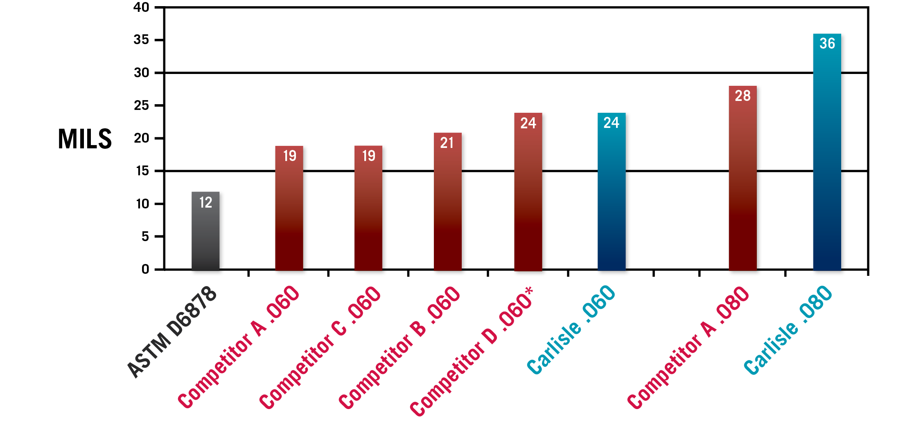
Thickness Over Scrim
While it's important to have a thick sheet, which is measured in the "Thickness Overall" test, "Thickness Over Scrim" measures the top-ply of the TPO membrane. TPO consists of a top-ply, scrim in the middle and a bottom ply. The top-ply is the front line of defense against the elements and the usable life of the membrane is compromised when the scrim is exposed. Thickness over scrim is a critical measurement when evaluating the potential longevity of a TPO roofing system.
*Competitor D is a premium-priced product compared to the other 4 samples.

Slide 15
Thickness Over Scrim
The top-ply of your TPO membrane is the first line of defense your building has against harmful weather. Thickness over scrim measurements can be misleading if the scrim is not properly embedded in the top and bottom ply.

Slide 16
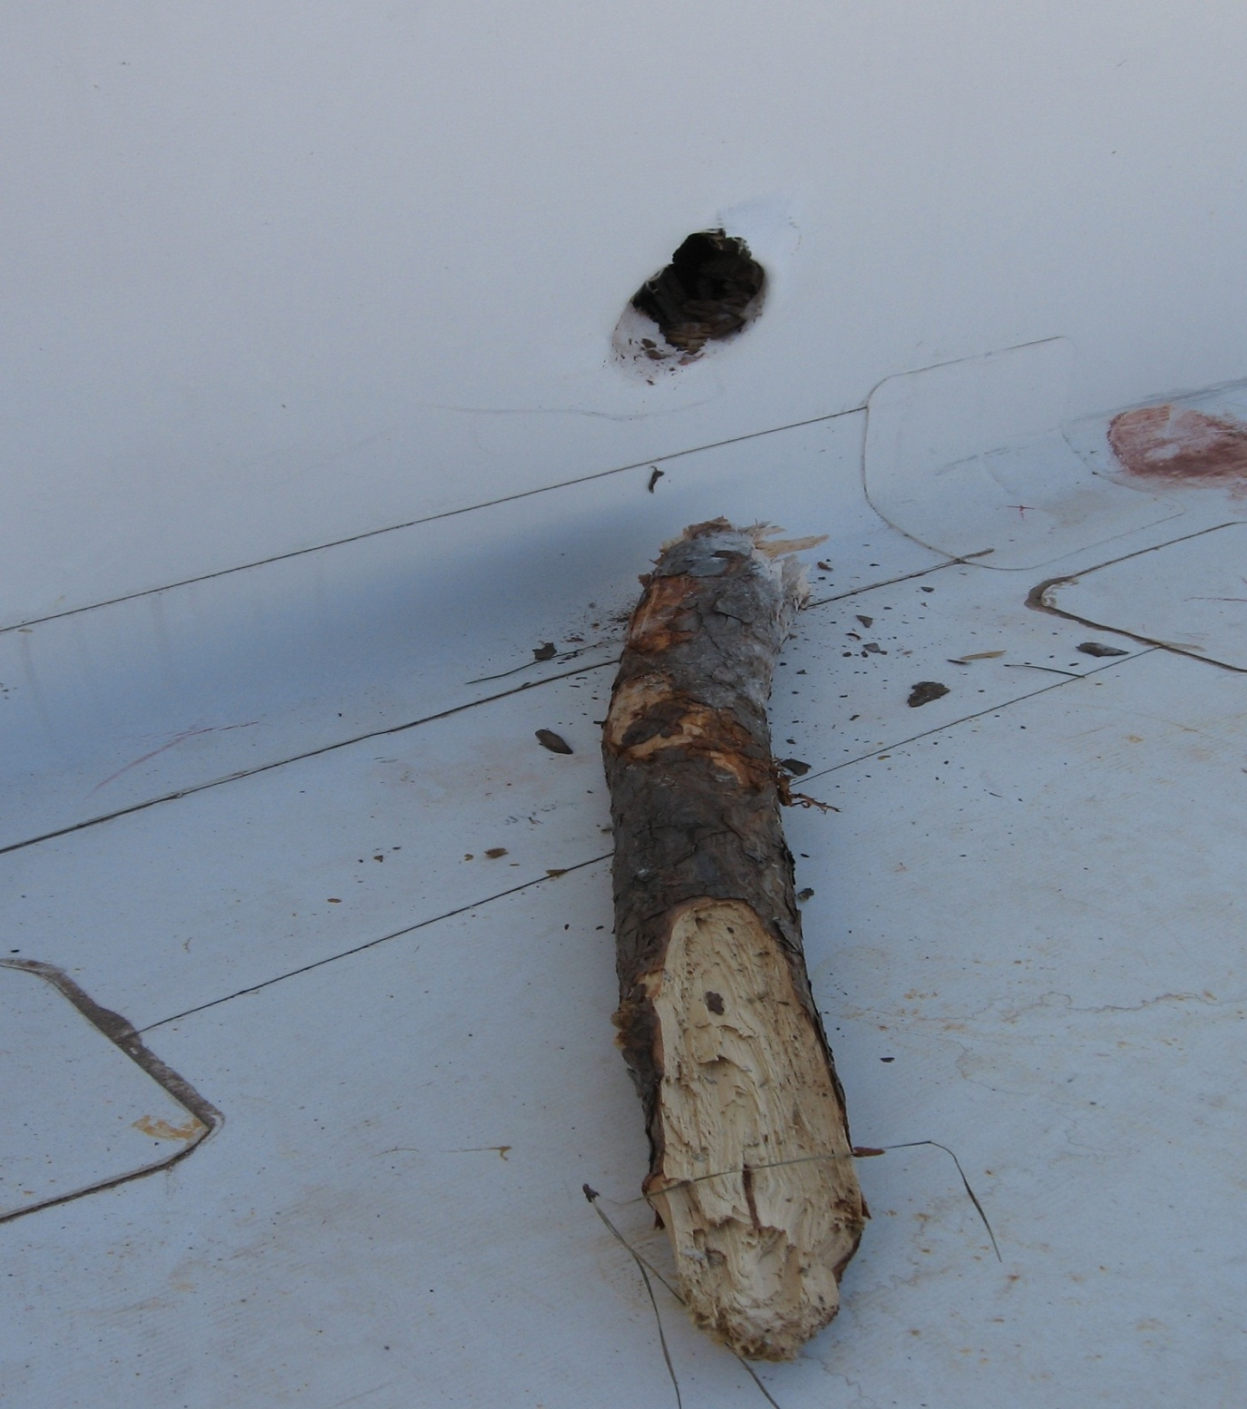
Puncture Resistance
There are many reasons to have a membrane with high puncture resistance.

Slide 17
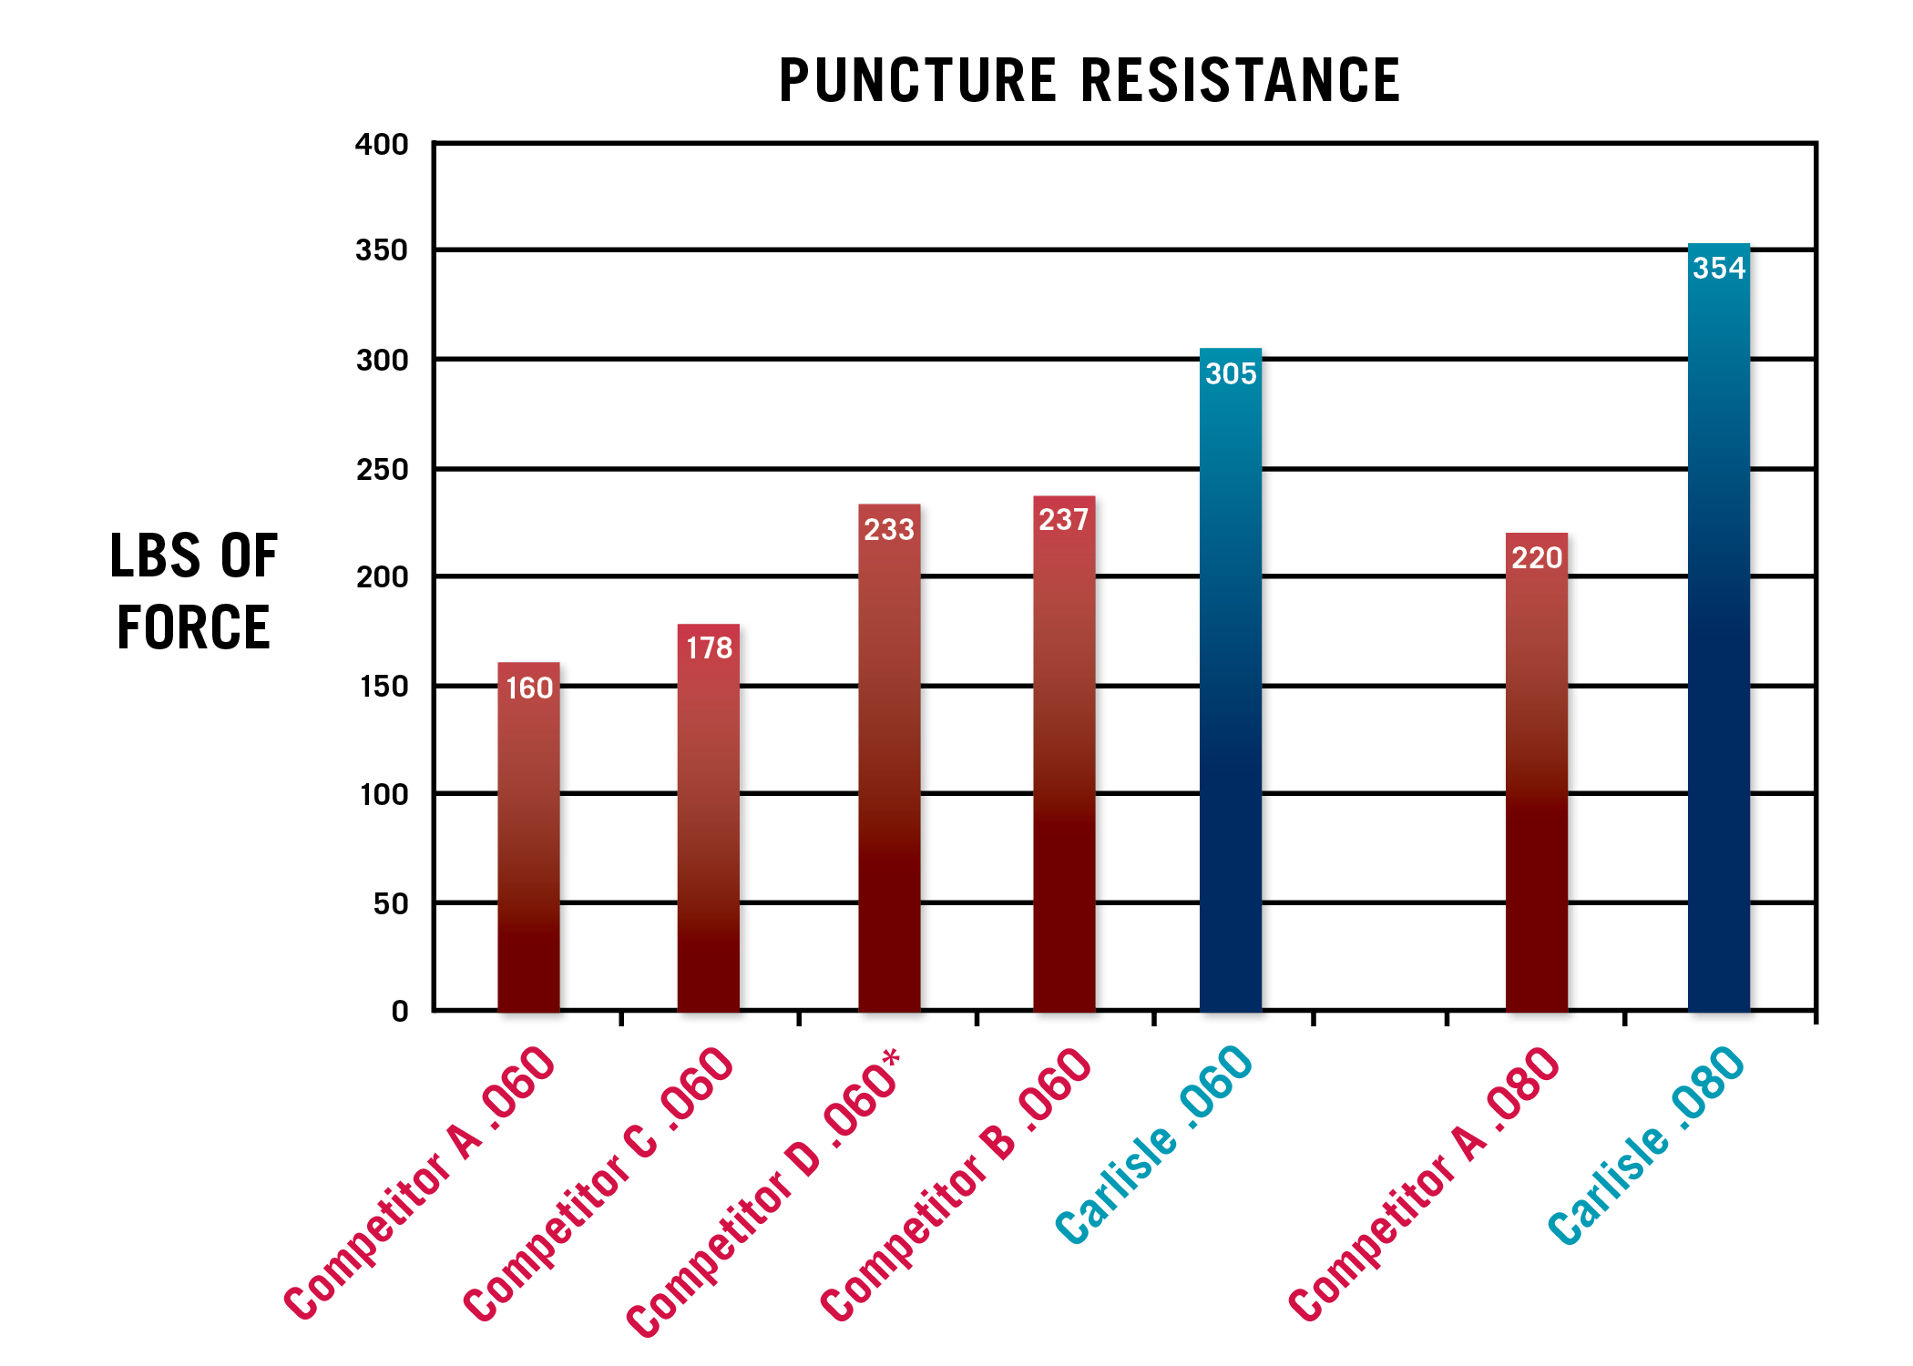
Puncture Resistance
On a properly installed TPO roofing system a common way for leaks to occur is through punctures in the membrane. By ensuring that the membrane installed has high puncture resistance and the manufacturer has the ability to provide an accidental puncture warranty, leaks due to punctures in the membrane can be mitigated and handled in a timely manner.
*Competitor D is a premium-priced product compared to the other 4 samples.

Slide 18
Carlisle Offers a Superior Weathering Package in Every TPO Membrane it Offers
OctaGuard XT is comprised of 8 Heat and UV stabilizers as well as antioxidents.

Slide 19
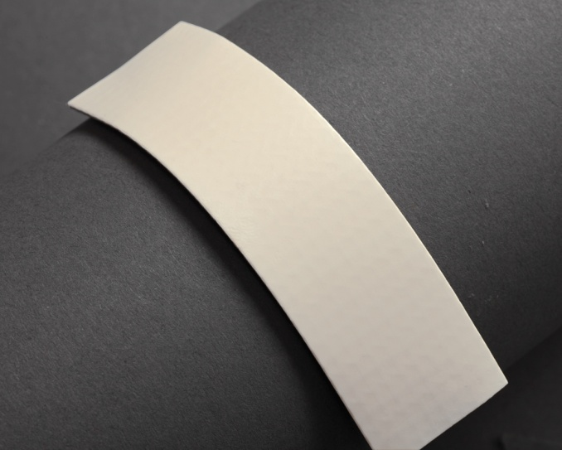
ASTM Has Increased The Requirement For Heat Aging
ASTM 2009 minimum 4 weeks @ 240°F
ASTM 2012 minimum 32 weeks @ 240°F
CARLISLE - 68 WEEKS No Failure
*32 weeks @ 240° F = 20 years @ 185° F for 6 hours per day

Slide 20
Heat Aging 240°F
Heat aging has been directly tied to the long-term performance of TPO. In 2011 ASTM increased the heat aging requirement for D6788 (Standard Specification for Thermplastic Polyolefin Based Sheet Roofing) from 4 weeks at 240°F to 32 weeks at 240°F, an 800% increase. Carlisle has been at the forefront of the movement to increase heat aging requirements for TPO. Carlisle’s Sure-Weld was able to nearly double the heat aging requirement of the improved standard long before it went into effect.
*Competitor D is a premium-priced product compared to the other 4 samples.

Slide 21
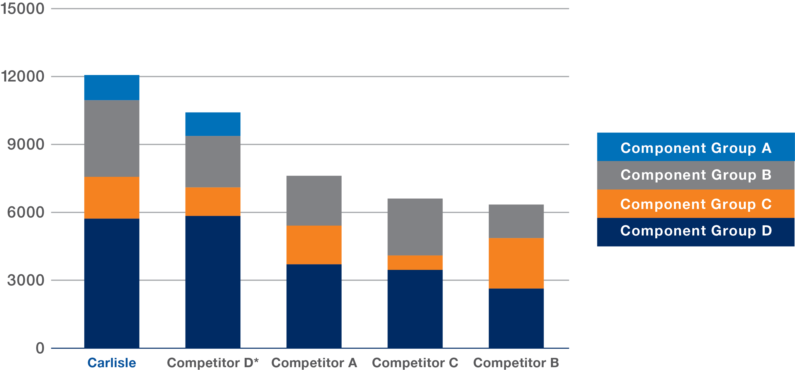
Weathering Package
Carlisle has been at the forefront of TPO development for nearly 20 years and continues to lead the industry with its high-performance OctaGuard XT weathering package that is incorporated into all Sure-Weld membrane and accessories. OctaGuard XT weathering package technology is comprised of eight performance-enhancing ingredients, including three heat-stabilizing antioxidants and three UV light stabilizers as well as organic and inorganic UV absorbers. When combined, these eight ingredients provide a weathering package second to none in the TPO industry.
*Competitor D is a premium-priced product compared to the other 4 samples.

Slide 22
Rank by Properties
After compiling all of the test data, a ranking system was applied to each of the TPO membranes. Each test was given the same weight in terms of importance. For each of the tests, the sample that performed the worst was given a score of 1, and the sample that performed the best was given a score of 7. Therefore this table reflects the cumulative score of all the tests.
*Competitor D is a premium-priced product compared to the other 4 samples.

