Slide 1
Patriot Jr.™
Equipment Overview

Slide 2
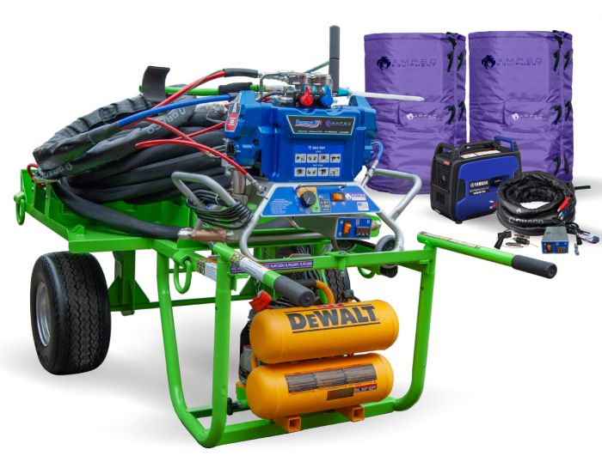
Overview of the machine’s capabilities and components
General instructions for operation, shutdown, maintenance, and prevention

Slide 3
Basic Functions
Able to dispense 2-part urethane low-rise adhesive
Accommodates 5-Gal Jugs/BIB and 15-Gal Drums
Intended to increase production compared to Dual Cartridge, Dual Tanks, and PaceCart

Slide 4
Customized cart holds Flexible FAST™ 5-Gal Jugs and 15-Gal Drums without additional attachments or conversion kits
PJR cart is designed to carry Graco pump, a DeWalt air compressor, and a 3000w generator without the need for additional carts on the roof
Includes a lockable compartment to store additional parts
Handle and wheel design makes cart easy to maneuver
Built-in forklift slots make transporting and loading the cart even easier

Slide 5
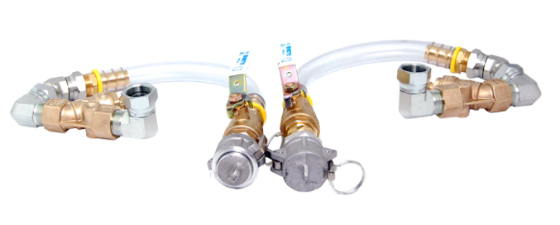
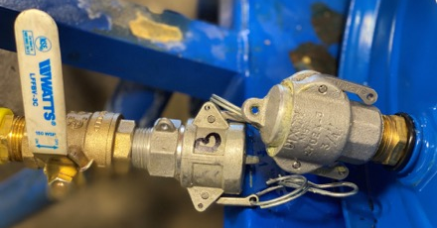
Fittings
The design for male/female fittings are mirrored for Part A and Part B to help avoid crossover
Each PJR comes with a set of reusable fittings to accommodate both packaging options – 5-Gal Jugs or 15-Gal Drums

Slide 6
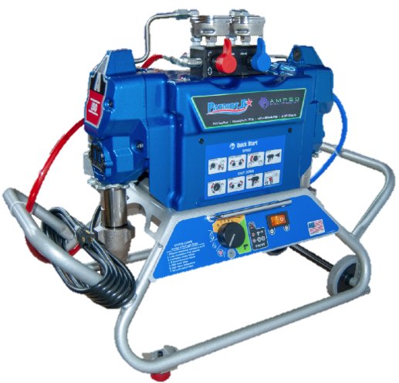
Graco Pump
Utilizes an OEM GRACO Reactor
Stays mounted on the PJR cart

Slide 7
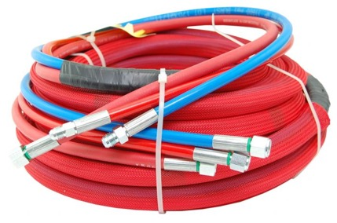
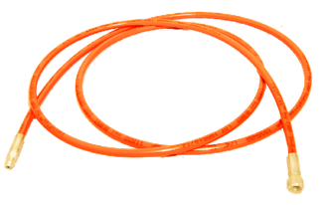
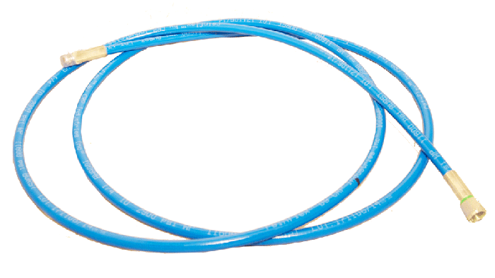
PJR Hoses
PJR Hose Bundle
Whip Hose
These are your primary hoses that move material from pump to gun
These are secondary hoses used to help prevent damage to primary hoses

Slide 8
Gun Options
Gun Options | Bead Application | Splatter Application | Air Purge Feature
Vee Manifold | X
Vee Air | X | X | X

Slide 9
PJR Setup

Slide 10
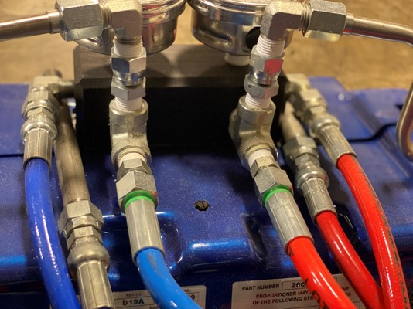
Brand New PJR Setup
If not already installed, mount the PJR Reactor onto the PJR Cart. MAKE SURE ALL CLIPS AND HOLD DOWNS ARE SECURE.
1
Connect fluid hoses to the pump and the gun. Ensure hoses are connected properly according to the PJR directions and videos.
2

Slide 11
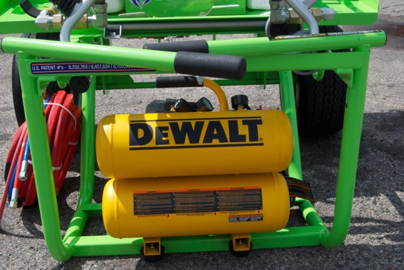
Brand New PJR Setup
If using the Vee-Air gun, mount the air compressor onto the bottom rack of the PJR cart. MAKE SURE ALL CLIPS AND HOLD DOWNS ARE SECURE.
3

Slide 12
Flexible FAST Drum Setup

Slide 13
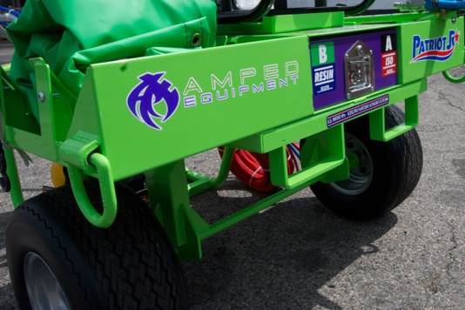
Flexible FAST Drum Setup
Ensure the storage compartment located on the backside (or drum side) of the PJR is closed and in a locked position.
1

Slide 14
Material Temperature
100°F (38°C)
Maximum Storage Temperature
95°F (35°C)
Material temperature for Flexible FAST adhesive must be at least 70°F for proper application to occur.
90°F (32°C)
Optimum Chemical Temperature at Time of Application
(Process core chemical temperature)
85°F (29°C)
80°F (27°C)
75°F (24°C)
70°F (21°C)
65°F (18°C)
60°F (16°C)
Temperature Range
55°F (13°C)
50°F (10°C)
Minimum Storage Temperature
45°F (7°C)
40°F (4°C)
25°F (2°C)
Minimum Surface Temperature

Slide 15
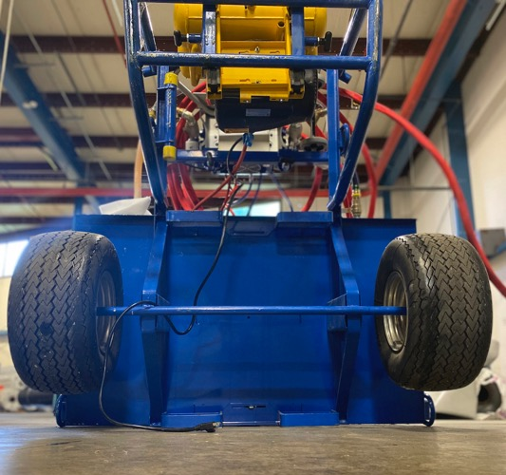
Flexible FAST Drum Setup
With the help of another person, carefully stand the PJR Cart in an upright position. DO NOT ATTEMPT WITH ONLY ONE PERSON.
2

Slide 16
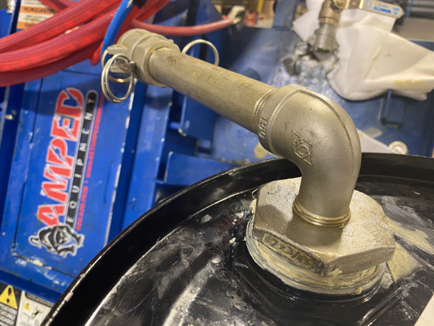
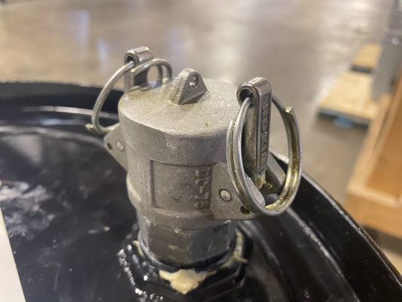
Flexible FAST Drum Setup
Carefully open the Flexible FAST drums and connect the PJR fittings. USE WHITE LITHIUM GREASE AT EVERY CONNECTION BEFORE FITTINGS ARE INSTALLED.
3
The large bung fitting connects to the desiccant dryer.
The small bung fitting connects the drum to the machine.

Slide 17
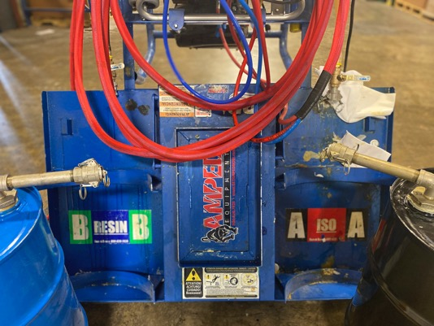
Flexible FAST Drum Setup
Using the color-coded labels located on the backside (or drum side) of the PJR, place each drum in a vertical position next to the PJR cart. Ensure each drum corresponds with the proper
A- and B-side.
4

Slide 18
Flexible FAST Drum Setup
Once all fittings have been installed and are absent of air/fluid leaks, you may then carefully place the drums onto the drum rack while it is in its vertical position.
5
NOTE: Once the A- and B-sides have been designated, DO NOT CROSS-CONTAMINATE WITH OPPOSITE CHEMICAL AT ANY TIME.

Slide 19
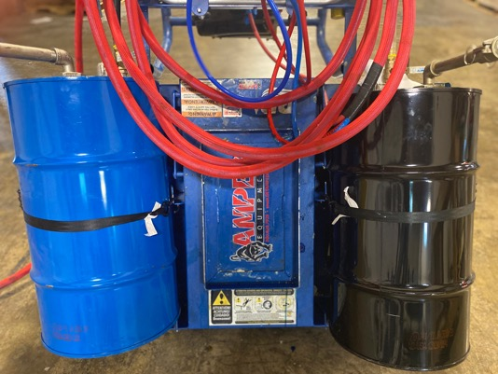
Flexible FAST Drum Setup
Secure drums firmly to the cart using the provided ratchet straps. Make sure drum straps are in the locked position before proceeding to the next step.
6

Slide 20
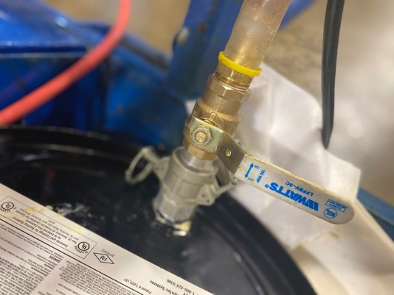
Flexible FAST Drum Setup
Connect corresponding cam lock fitting to A and B drums and ensure vent pipes remain capped.
7
DOUBLE CHECK ALL FITTINGS AND CLIPS to ensure everything is secure and tightened.
DOUBLE CHECK FLUID VALVES to ensure they are in the closed position.

Slide 21
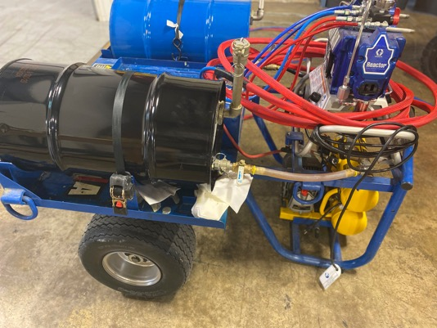
Flexible FAST Drum Setup
With the help of another person, pull the PJR Cart down from the upright position.
8
Pull the PJR Cart all the way down so that the drums are parallel to the deck. Ensure both the wheels and rear legs are firmly on the deck.

Slide 22
Changing Drums

Slide 23
Switching out Flexible FAST Drums
Ensure all fluid valves are closed and machine has been properly powered down.
1
Ensure Flexible FAST Drums are strapped to the cart and the storage compartment is closed and in a locked position.
2
With the help of another person, carefully stand the PJR cart in an upright position. DO NOT ATTEMPT with only one person.
3
Remove ratchet straps from the drums.
4
Remove the PJR fittings from the used drums and install bung caps into the bung holes.
5
To install new drums onto the PJR cart, refer to steps 4-8 from Flexible FAST Drum Setup.
6

Slide 24
Startup and Dispensing

Slide 25
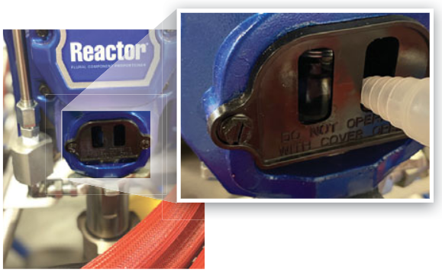
Daily Startup and Dispensing Procedures
Apply a small amount of pump lube to each piston on the A- and B-side pumps.
1

Slide 26
Daily Startup and Dispensing Procedures
If using a generator, place the generator in the tray between the drums. Ensure it is properly fueled and oiled.
2
Plug the PJR cord into your power source.
DO NOT USE IDLE CONTROL if using a generator.
3

Slide 27
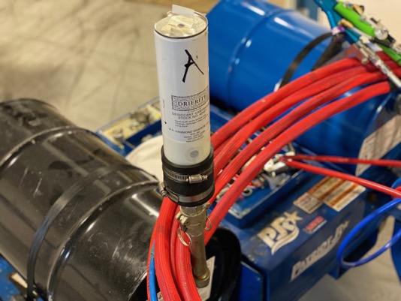
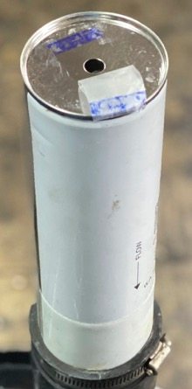
Daily Startup and Dispensing Procedures
Remove the tape on the top and bottom sides of each desiccant drier. Install a desiccant drier into the vent fittings on each drum.
4

Slide 28
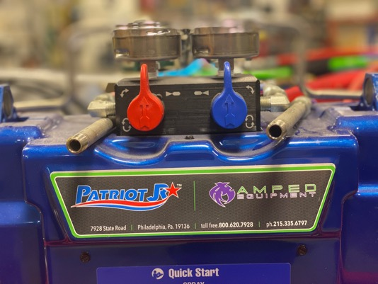
Daily Startup and Dispensing Procedures
Before turning on the PJR machine, ensure that both recirculation valves are completely closed.
5

Slide 29
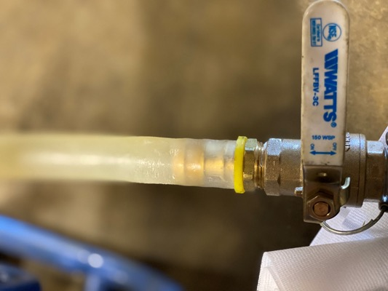
Daily Startup and Dispensing Procedures
Completely open both fluid valves leading from the drums.
6
You should see A- and B-side materials fill up the clear tubing prior to the next step.
Fluid Valve (closed position)

Slide 30
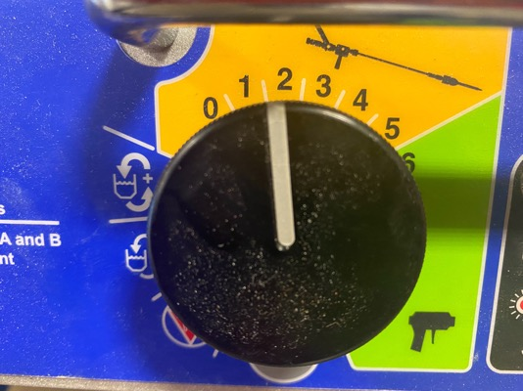
Daily Startup and Dispensing Procedures
Turn the orange power switch to “on”.
7
Without a mixing tip, open valves on the gun and set the flow dial to 1 or 2. This will start pulling material throughout the pump, hose, and gun.
8

Slide 31
Daily Startup and Dispensing Procedures
Check for two equal streams of A- and B- chemical to visibly flow from the gun.
9
Once fluids are flowing evenly with no air pockets, close the fluid valves on the gun and turn the safety to “on”. Apply white lithium grease to the threads on a NEW static mixing tip and install mixing tip on the gun.
10

Slide 32
Bead Application
When beads or ribbons are specified at 4”, 6”, or 12” on-center.
11

Slide 33
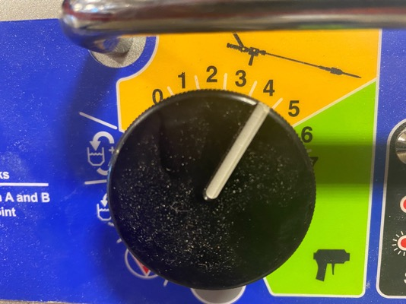
Daily Startup and Dispensing Procedures
a
With gun valves closed, turn the flow dial to 3-5.

Slide 34
Daily Startup and Dispensing Procedures
b
Release the safety and open fluid valves on the gun to begin applying adhesive.
c
Ensure the adhesive is dispensed at a minimum ½”- ¾” wet bead and proper spacing is followed.

Slide 35
Wet Bead
Foam Bead with String Time

Slide 36
Splatter Application
The following equipment and settings listed MUST be followed for approved splatter application.
12

Slide 37
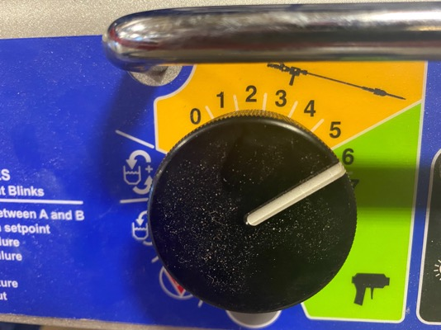
Daily Startup and Dispensing Procedures
a
PJR Flow Dial Setting: 6

Slide 38
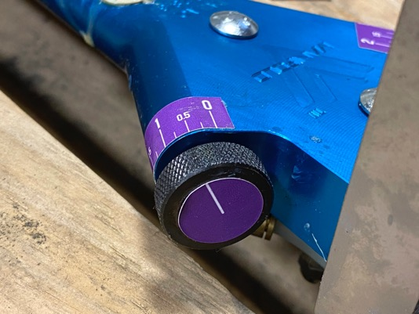
Daily Startup and Dispensing Procedures
b
Air compressor pressure: 80psi
c
Air setting on gun: 1/8 turn or 0.5 setting.
Open ONE valve only.
NOTE: Pressure may need to be adjusted depending on the temperature of the material.
d
Fluid valves on gun: 100% open

Slide 39
Initial Splatter
Splatter with String Time

Slide 40
Daily Startup and Dispensing Procedures
When you have reached a stopping point, ensure the gun is pointed in a safe direction and close any open fluid or air valves on the gun.
13
Once valves are closed, discard the static mixing tip and replace with a new one.
14

Slide 41
Short-Term Shutdown

Slide 42
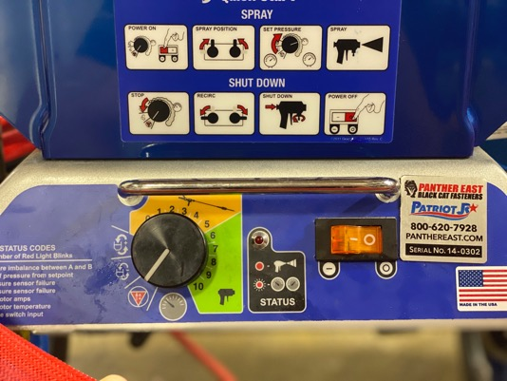
Short-Term Shutdown Checklist (overnight/lunch break)
Ensure you have reached a proper stopping point and the gun valves are closed.
1
Turn down the fluid dial to its “off” position, turn off the power switch, and unplug the power cord on the PJR.
2

Slide 43
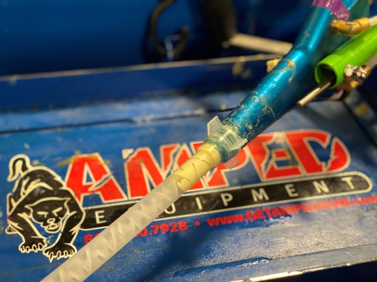
Short-Term Shutdown Checklist (overnight/lunch break)
Apply a new static mixing tip and apply white lithium grease through the grease fittings on the gun. Fill mixing tip with about 2”-3” of grease.
3

Slide 44
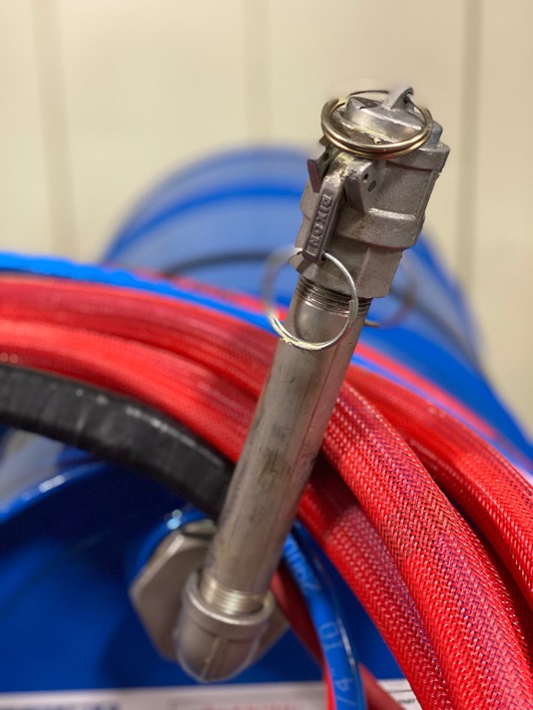
Short-Term Shutdown Checklist (overnight/lunch break)
4
Close both fluid valves leading from the drums to the pump.
5
Remove desiccant driers from the drums. Apply tape to the top of each drier and cover with a plastic bag as needed.
6
Add caps back on the vent tube top. Remember to use white lithium grease on all fittings.

Slide 45
Short-Term Shutdown Checklist (overnight/lunch break)
Apply a small amount of pump lube to each piston.
7
Wrap up hose and gun and protect all equipment with the provided green PJR cover. Secure as needed.
8

Slide 46
Long-Term Shutdown

Slide 47
Long-Term Shutdown Checklist (2 weeks or longer)
Ensure the gun valves are closed and the machine has been shut down properly.
1
Close both fluid valves leading from the drums to the pump.
2
Remove desiccant driers from the drums. Apply tape to the top of each drier and cover with a plastic bag as needed.
3
Add caps and plugs back on the vent tube top. Remember to use white lithium grease on all fittings.
4
With the help of another person, carefully stand the PJR Cart in an upright position. DO NOT ATTEMPT with only one person.
5

Slide 48
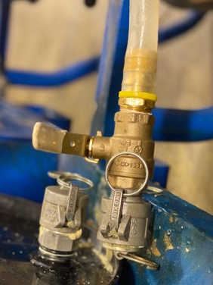
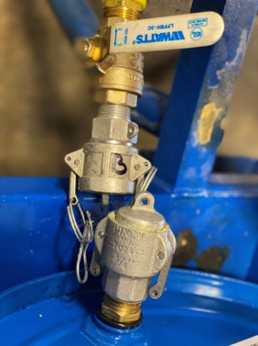
Long-Term Shutdown Checklist (2 weeks or longer)
Disconnect inlet hoses from the drums. Ensure fittings on the drums have been properly plugged/capped.
6
Side A
Side B

Slide 49
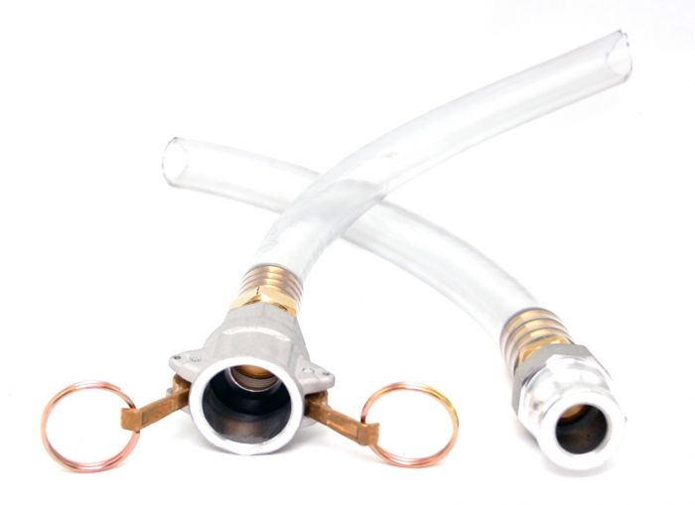
Long-Term Shutdown Checklist (2 weeks or longer)
Using the open end of the additional set of connect hoses provided, connect the appropriate A- and B-side inlet cam locks.
7

Slide 50
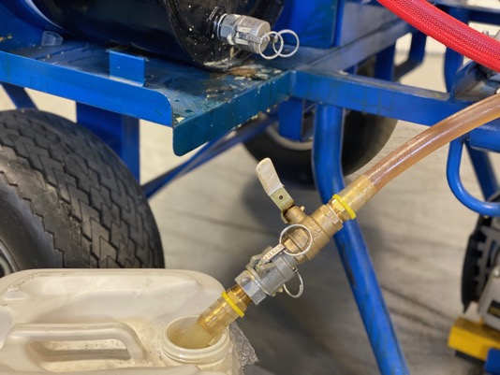
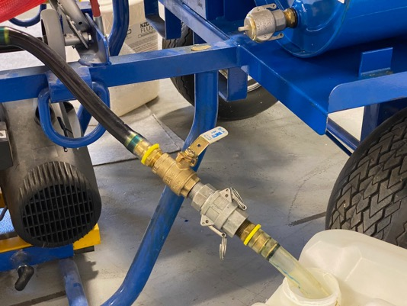
Long-Term Shutdown Checklist (2 weeks or longer)
Place A-side hose in a container of ISO Flush.
8
Place B-side hose into a container of ISO Flush.
9

Slide 51
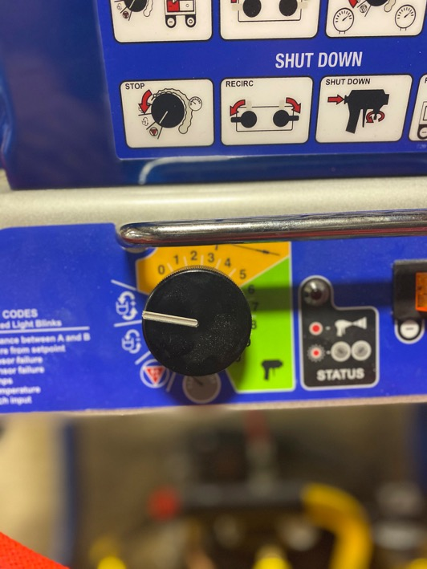
Long-Term Shutdown Checklist (2 weeks or longer)
Using an empty trash receptacle, open both fluid valves from the drums and both fluid valves on the gun.
10
Turn on power and set flow dial to “circulate” and allow flush to run through pump, hose, and gun until clear fluid is observed.
11

Slide 52
Long-Term Shutdown Checklist (2 weeks or longer)
Once clear fluid is observed, close fluid valves on the gun AND from the drums.
12
Turn fluid dial to “off”.
13
Pull the flush hoses from the ISO Flush containers and insert hoses into new containers of Surf-A-Lube.
14
Using a trash receptacle, open both fluid valves from the drums and both fluid valves on the gun.
15
Turn flow dial to “circulate” and allow lube to run through pump, hose, and gun until clear lube is present.
16

Slide 53
Long-Term Shutdown Checklist (2 weeks or longer)
Once clear lube is observed, close fluid valves on the gun and from the drums.
17
Turn the fluid dial to its “off” position, turn off the power switch, and unplug the power cord on the PJR.
18

Slide 54
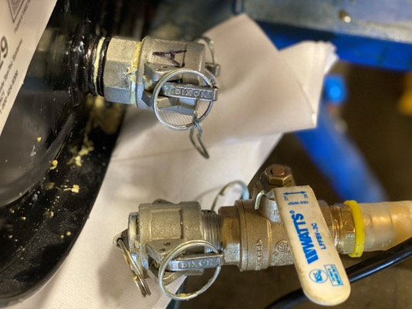
Long-Term Shutdown Checklist (2 weeks or longer)
Apply a new static mixing tip and apply grease through the grease fittings on the gun. Fill mixing tip with about 2”-3” of grease.
19
Disconnect additional connector hoses and install plugs/caps on cam locks.
20

Slide 55
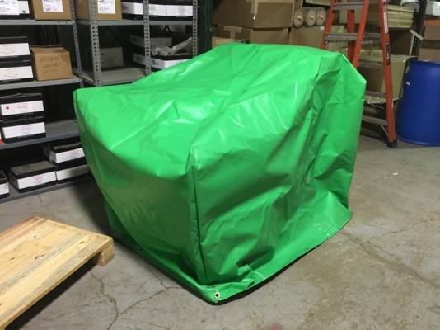
Long-Term Shutdown Checklist (2 weeks or longer)
Wrap up hose and gun and protect all equipment with the provided green PJR cover. Secure as needed.
21

Slide 56
Prevention and Troubleshooting

Slide 57
Prevention
Use white lithium grease for all fittings, securements, plugs/caps, and mixing tips. This helps prevent material buildup and seals all possible passages for air and moisture.
1
Apply pump lube before and after each use to both pistons.
2
Letter-label or color-code fittings, desiccant driers, plugs/caps, and containers. This helps ensure that fittings and accessories stay on their designated A- or B-side.
3
Ensure all openings have been plugged unless being vented properly.
*Replace desiccant driers when needed.
Blue = good
Pink = needs replaced
4
When in doubt, flush it out. Flushing your machine regularly and often will significantly increase the operating life of your PJR and reduce downtime on the jobsite.
5

Slide 58
Troubleshooting Tips
Proper storage of material is essential. Ensure the material temperature of Flexible FAST is 70°F at all times.
Ensure hose assemblies from the drums are clear of debris or crystals. Replace if needed.
1
6
Ensure both passages in the gun are clear by using a 1/4" drill bit.
Ensure all fittings are completely secure and tightened with no air leaks.
2
7
Ensure both check valves from the drums are open completely.
Ensure hoses are free of all kinks and twists.
3
8
Ensure both ends of the desiccant driers are completely open.
Ensure a new static mixing tip is being used after stopping for 30 seconds or longer.
4
9
Ensure the Y-screens are clear and free of debris or crystals. Replace if needed.
5

Slide 59
Adhesive Cost Savings with the Patriot Jr.

Slide 60
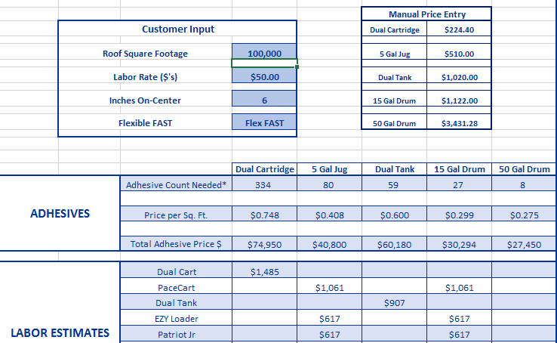

Slide 61
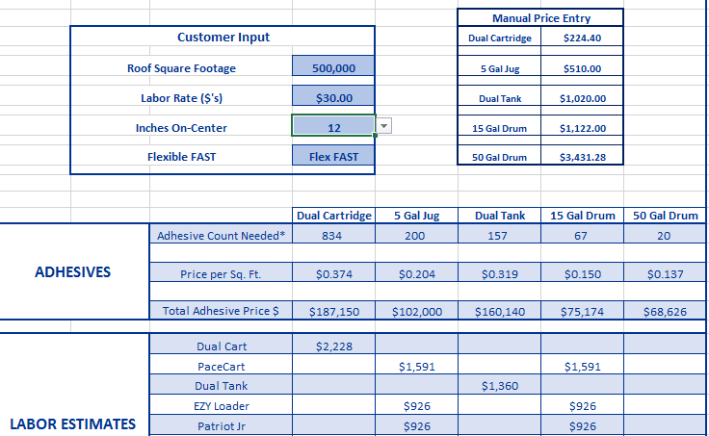

Slide 63
Questions?

