Slide 1
HULK
Equipment Overview

Slide 2
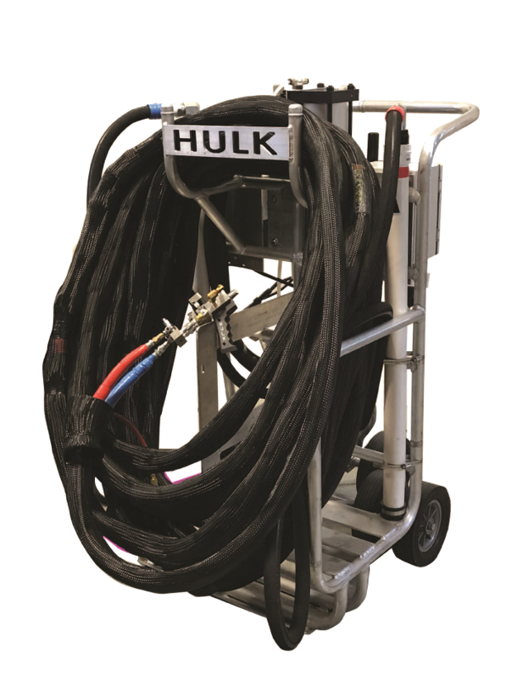
Overview of the machine’s capabilities and components
General instructions for operation, shutdown, maintenance, and prevention

Slide 3
Basic Functions
Able to dispense 2-part urethane, low-rise adhesive
Accommodates 15-Gal Drums and 50-Gal Drums
Intended to increase production compared to Dual Cartridge, Dual Tanks, PaceCart

Slide 4
HULK Cart
Customized cart capable of dispensing Flexible FAST™ 15-Gal and 50-Gal drums without additional attachments or conversion kits
Includes a recirculation block that greatly reduces the time it takes to warm up your adhesive
Easy-tilt design makes cart safe and easy to maneuver
34” wide frame allows the HULK to fit through any sized door

Slide 5
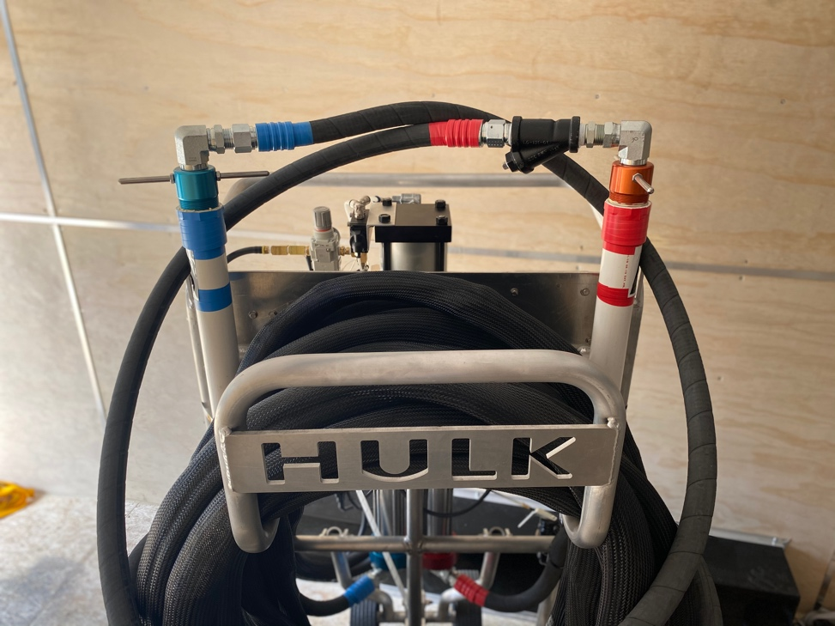
Suction Tubes
Each HULK comes with a set of suction tubes that fit both 15-Gal and 50-Gal drums
Suction tubes remove the need for additional connections or barrel pumps

Slide 6
HULK Hose
HULK
Heated Hose Assembly
(Recommended)
Heated Hose
These are your primary hoses which moves material from pump to gun.
*Non-heated hoses are available.

Slide 7
Gun Options
Gun Options | Bead Application | Splatter Application | Air Purge Feature
HULK Gun | X | X | X

Slide 8
HULK Setup

Slide 9
Brand New HULK Setup
Follow the steps listed under “Flexible FAST Drum Setup.” This would include:
1
Opening the drums
Inserting the fluid draw tubes
Installing desiccant driers

Slide 10
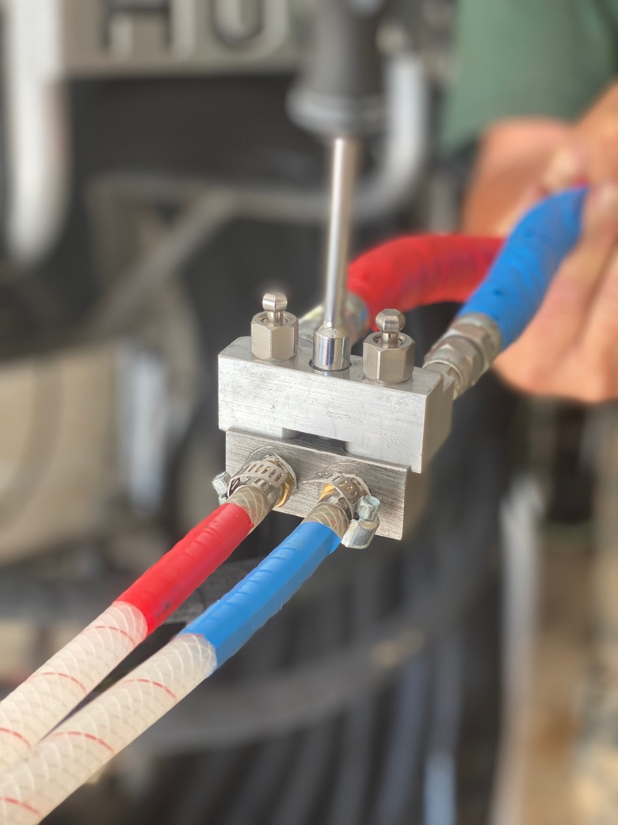
Brand New HULK Setup
2
Attach the air hose between HULK machine and air compressor.
3
Power up the air compressor.
4
Install recirculation block and ensure fittings are tight, secure, and absent of fluid or air leaks.

Slide 11
Brand New HULK Setup
5
Tighten pump packing.
6
Place both ends of recirculation block into an empty trash receptacle.
7
Open manifold shutoff valves.

Slide 12
Brand New HULK Setup
Slowly raise air regulator until machine begins to cycle (low pressure).
8
Let the material flow through the entire hose assembly until there is continuous flow with no air pockets.
9
Lower air regulator to 0psi.
10
Close both manifold valves.
11
Remove recirculation block.
12

Slide 13
Flexible FAST Drum Setup

Slide 14
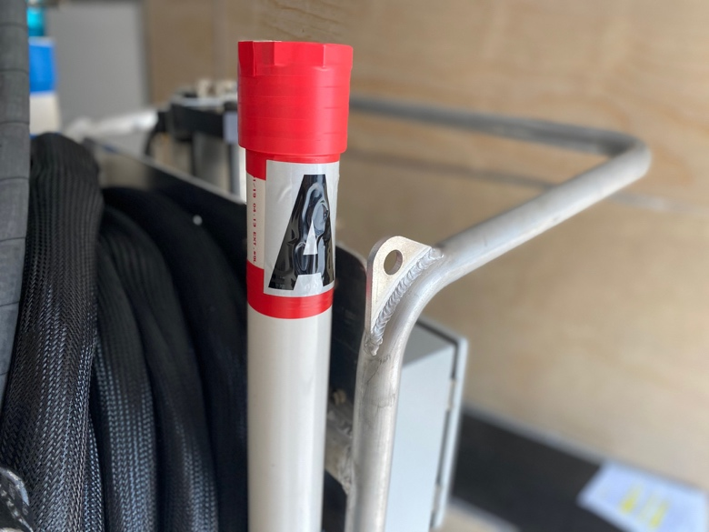
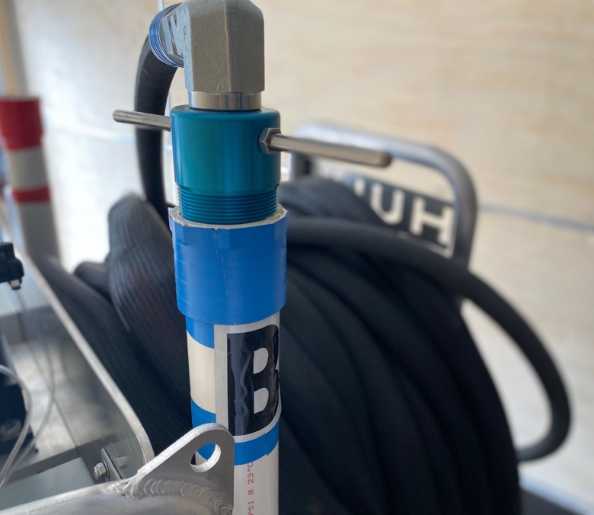
Flexible FAST Drum Setup
Set drums “A” and “B” on the correct sides of the machine. Color-coded labels are placed on each storage tube located on each side of the machine.
1
NOTE: 15-Gallon Drums can be placed directly on the HULK’s drum rack if desired.

Slide 15
Material Temperature
100°F (38°C)
Maximum Storage Temperature
95°F (35°C)
Material temperature for Flexible FAST adhesive must be at least 70°F for proper application to occur.
90°F (32°C)
Optimum Chemical Temperature at Time of Application
(Process core chemical temperature)
85°F (29°C)
80°F (27°C)
75°F (24°C)
70°F (21°C)
65°F (18°C)
60°F (16°C)
Temperature Range
55°F (13°C)
50°F (10°C)
Minimum Storage Temperature
45°F (7°C)
40°F (4°C)
25°F (2°C)
Minimum Surface Temperature

Slide 16
Flexible FAST Drum Setup
Ensure material temperature is correct and, if needed, apply heated blankets to ensure proper temperatures are retained.
2
Carefully open the Flexible FAST drums. USE WHITE LITHIUM GREASE AT EVERY CONNECTION BEFORE FITTINGS ARE INSTALLED.
The large bung connects the drum to the machine.
The small bung connects to the desiccant dryer.
3

Slide 17
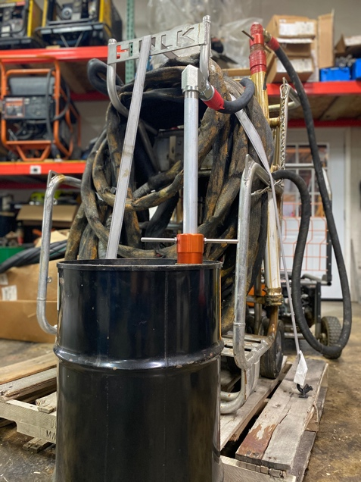
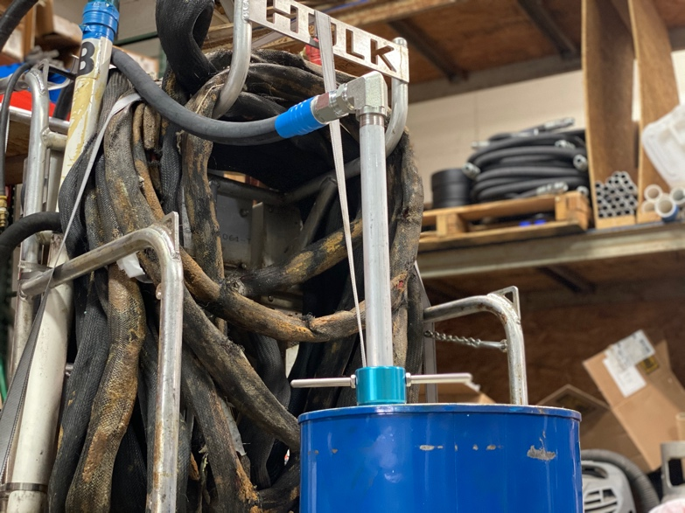
Flexible FAST Drum Setup
Insert fluid draw tubes in corresponding “A” and “B” drums.
4
NOTE: Once the A- and B-sides have been designated, do not cross contaminate with opposite chemical at any time.

Slide 18
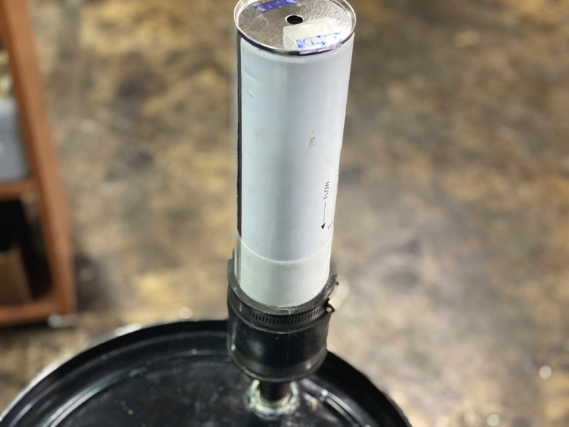
Flexible FAST Drum Setup
Remove tape from both ends and install the desiccant driers to both A- and B-side drums.
5

Slide 19
Changing Drums

Slide 20
Switching out Flexible FAST Drums
Ensure dispensing has completely stopped and the HULK gun is in its “off” position.
1
Place the new set of Flexible FAST “A” and “B” drums on the correct sides of the machine.
2

Slide 21
Switching out Flexible FAST Drums
Carefully open the new Part A drum of Flexible FAST.
Remove the desiccant drier from the empty drum of Part A and install it into the small bung on the newly opened drum of Part A .
Remove the pickup tube from the empty drum of Part A and install it into the large bung on the newly opened drum of Part A .
3
Carefully open the new Part B drum of Flexible FAST.
Remove the desiccant drier from the empty drum of Part B and install it into the small bung on the newly opened drum of Part B .
Remove the pickup tube from the empty drum of Part B and install it into the large bung on the newly opened drum of Part B .
4

Slide 22
Startup and Dispensing

Slide 23
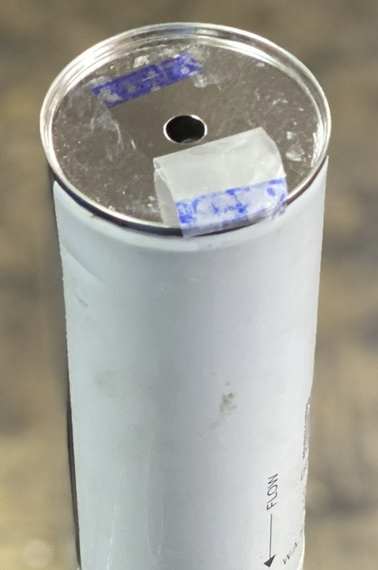
Daily Startup and Dispensing Procedures
Ensure air compressor and generator are set up properly according to manufacturer’s instructions.
1
Ensure tape has been removed on desiccant driers and they remain completely open during rig use.
2

Slide 24
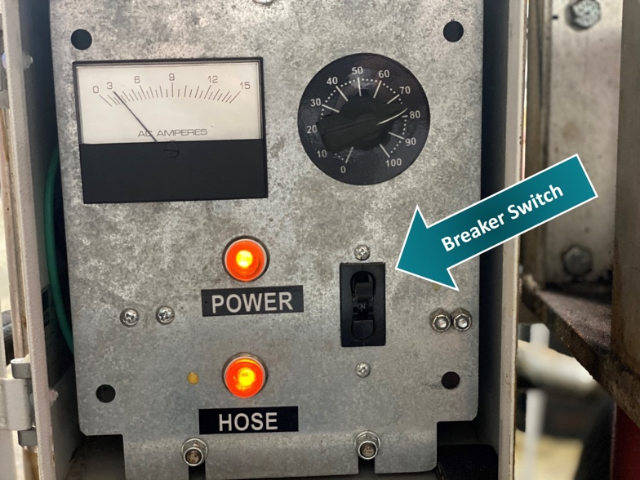
Daily Startup and Dispensing Procedures
3
If using a heated hoes, attach extension cord between generator and the HULK. If not, skip to Step #6.
4
Breaker Switch
Power up generator.
5
Turn on breaker and adjust dial to appropriate setting for jobsite conditions.

Slide 25
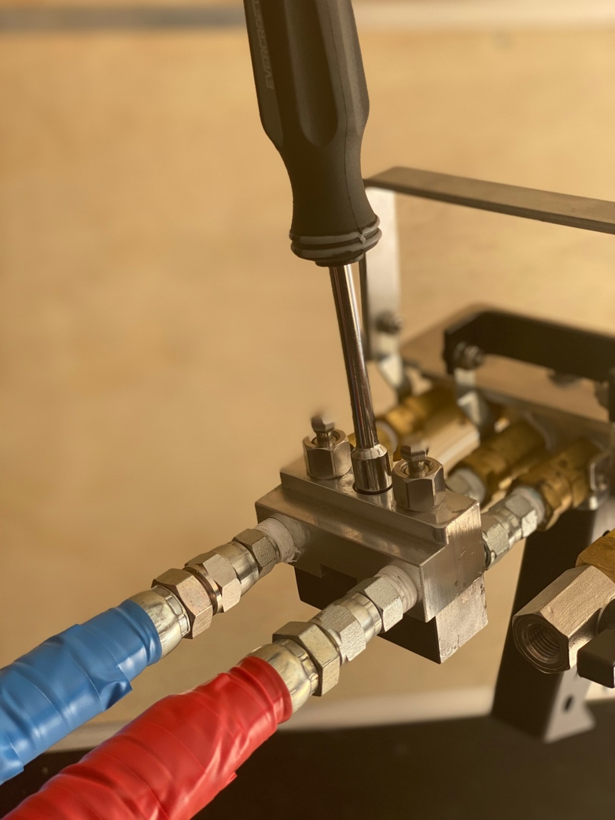
Daily Startup and Dispensing Procedures
Attach air hose between HULK machine and air compressor.
6
Attach the HULK gun to the hose assembly and ensure fittings are tight, secure, and absent of fluid or air leaks.
7

Slide 26
Daily Startup and Dispensing Procedures
Power up air compressor
8
Check gauges for equal pressure on A- and B- sides.
9
Apply white lithium grease to the threads on a NEW static mixing tip and install the mixing tip onto the gun.
10

Slide 27
Bead Application
When beads or ribbons are specified at 4”, 6”, or 12” on-center.
11

Slide 28
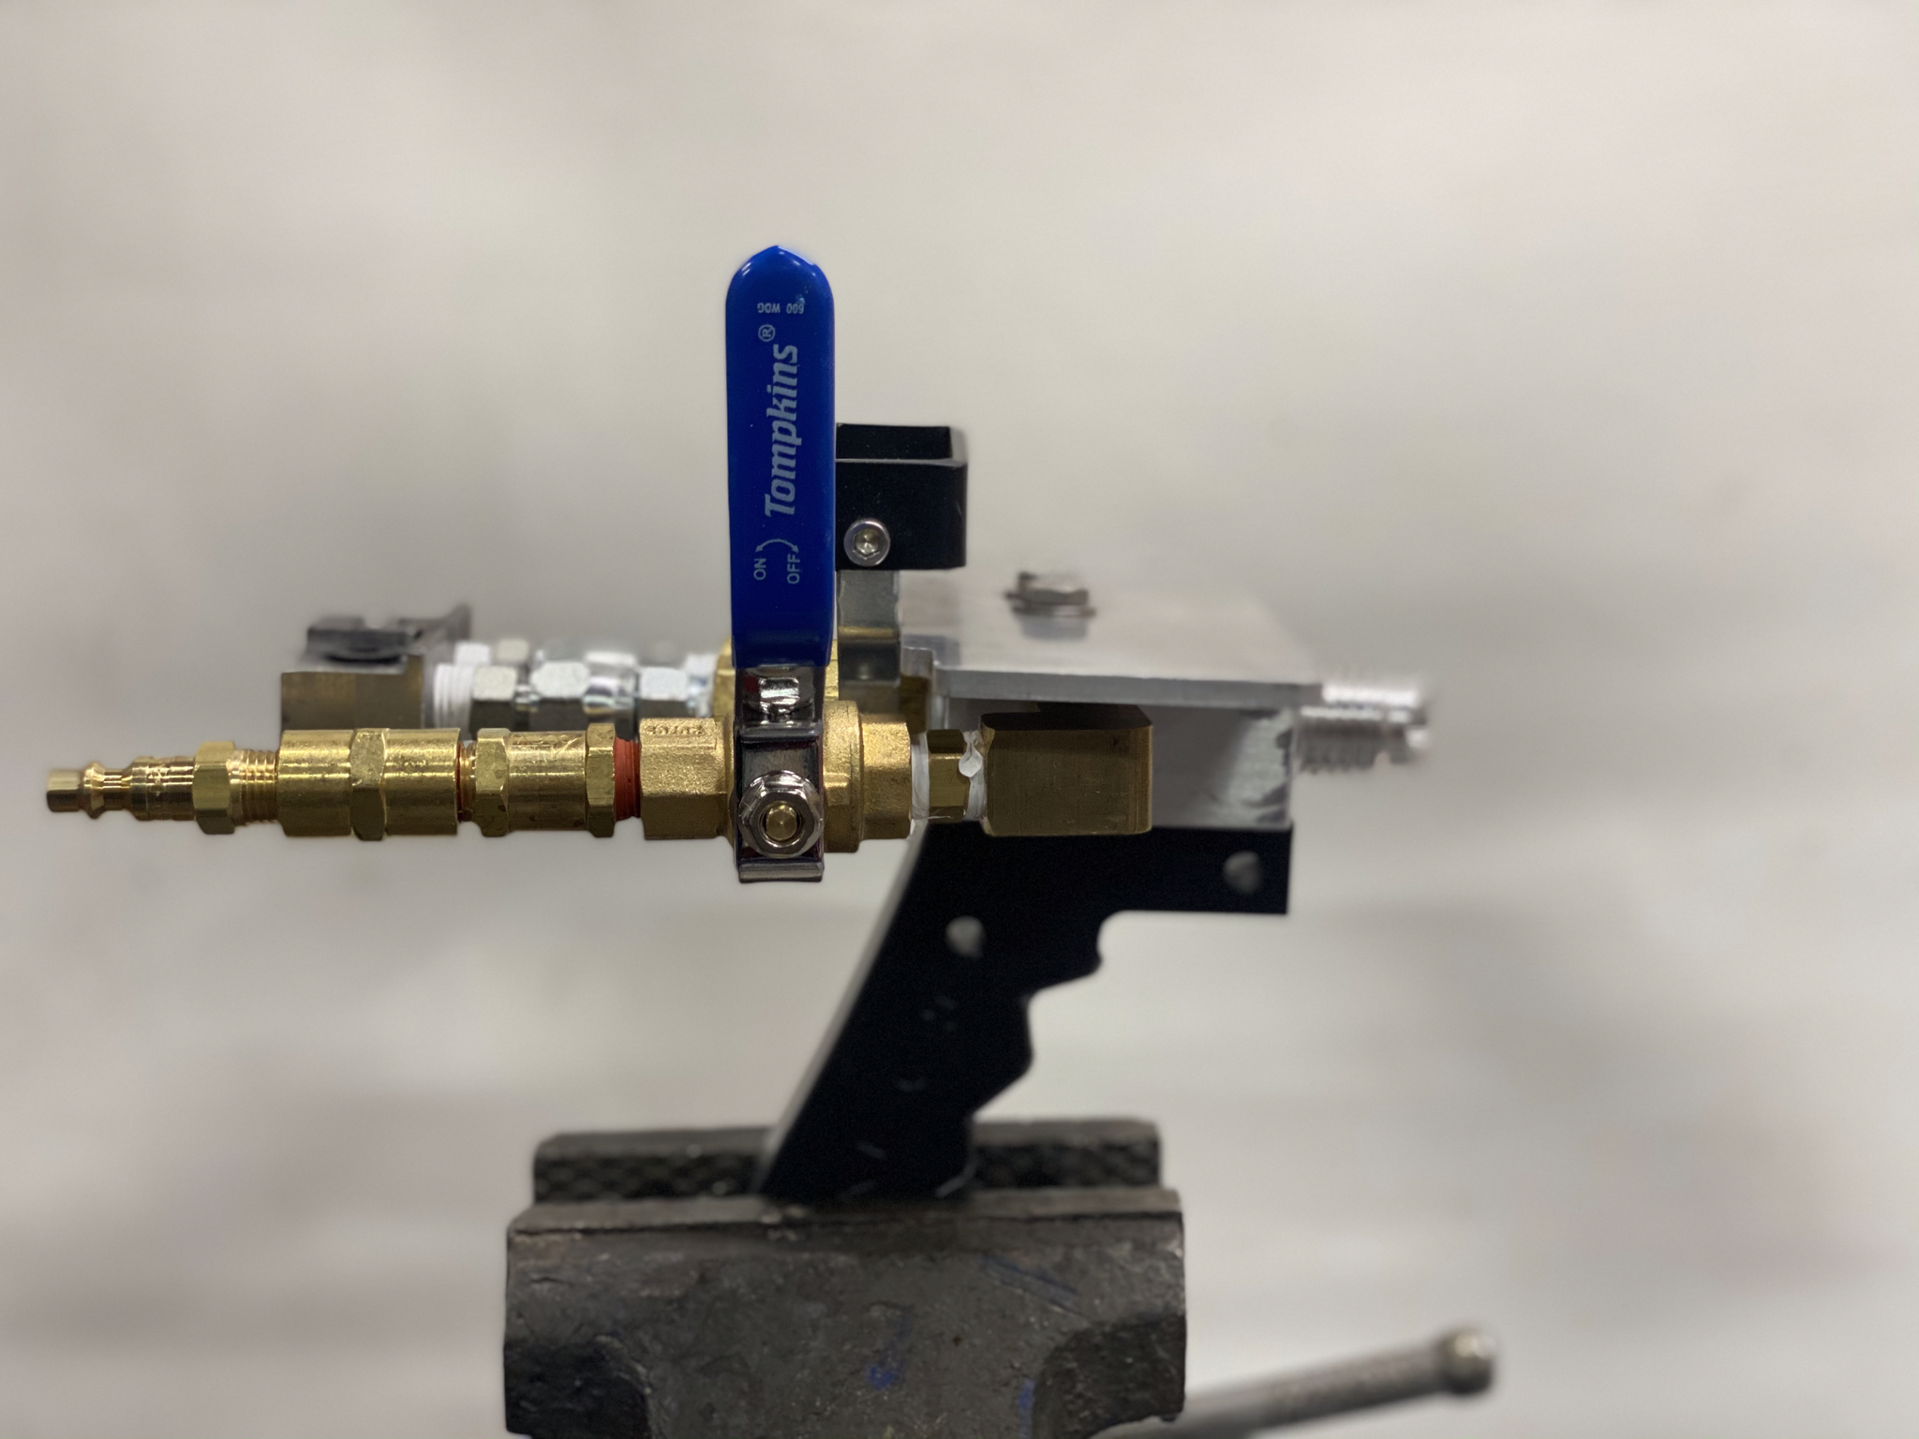
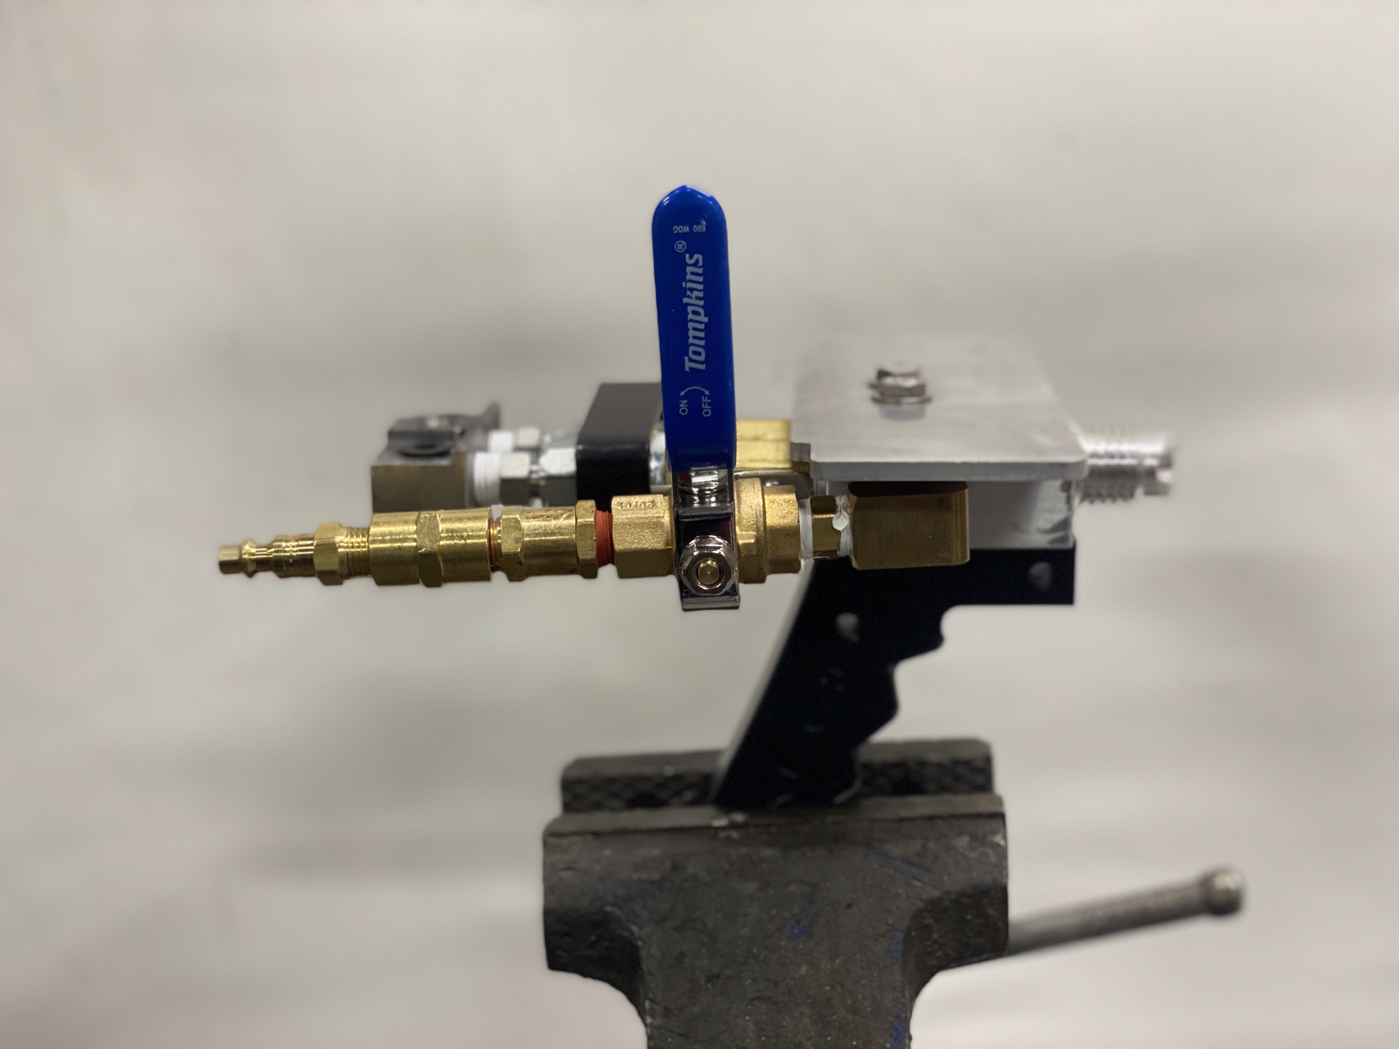
Daily Startup and Dispensing Procedures
a
Raise air pressure to appropriate setting. Manufacturer recommendation is 50psi.
Lower settings provide a slower speed of application.
Higher settings provide a faster speed of application.
Fluid Handle
b
Open fluid handle completely to begin application of adhesive.

Slide 29
Closed
Open
Fluid Handle

Slide 30
Daily Startup and Dispensing Procedures
Ensure the adhesive is dispensed at a minimum ½”- ¾” wet bead and proper spacing is followed.
C

Slide 31
Wet Bead
Foam Bead with String Time

Slide 32
Splatter Application
The following equipment and settings listed MUST be followed for approved splatter application.
12

Slide 33
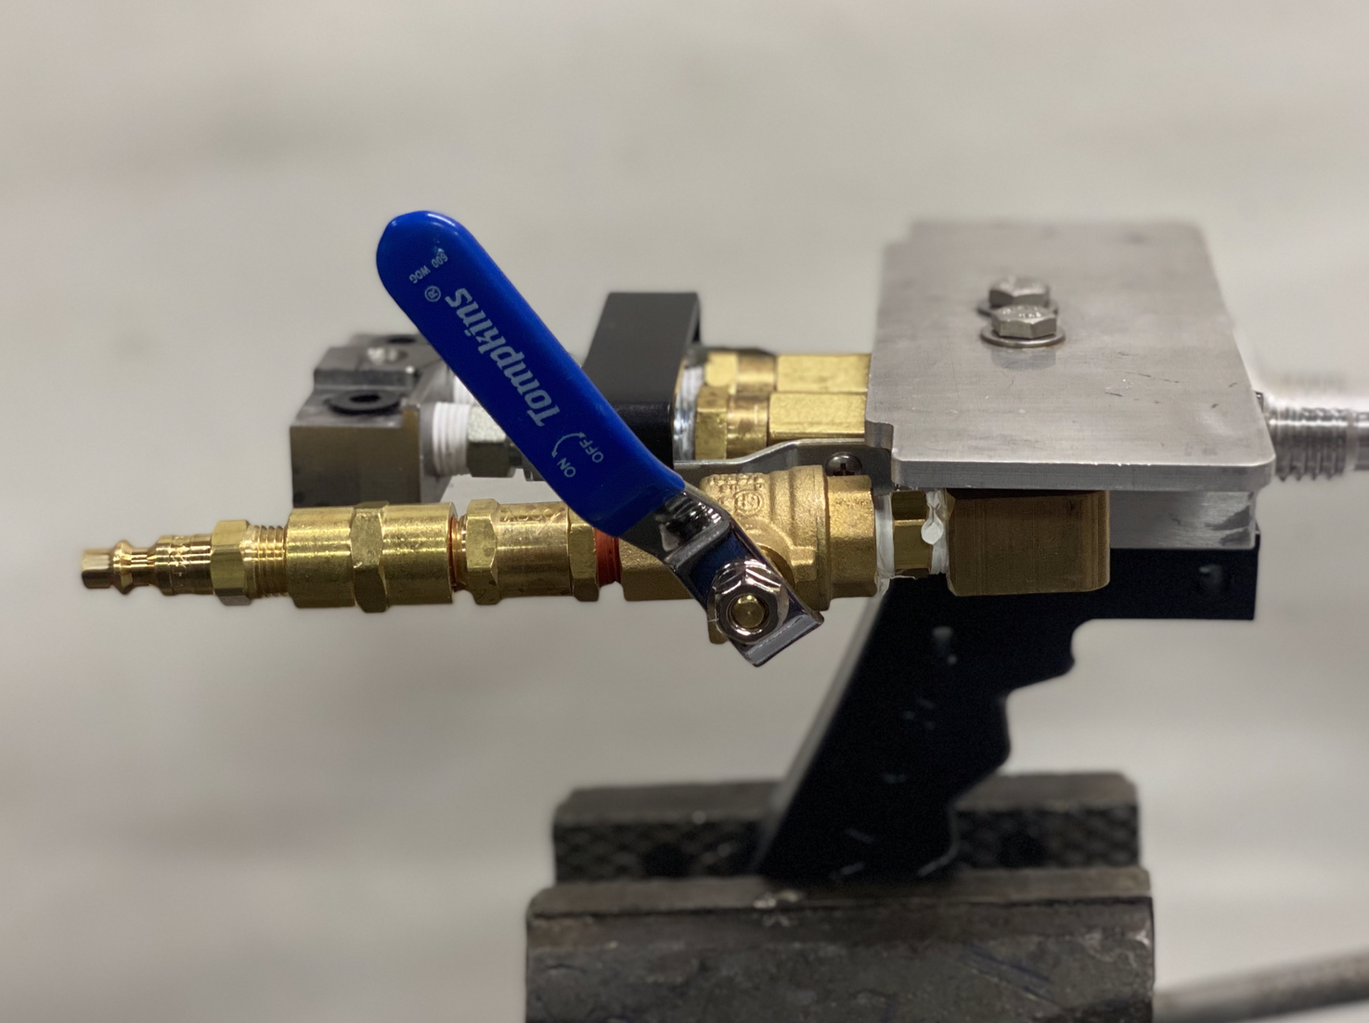
Daily Startup and Dispensing Procedures
Equipment Setting: 60psi
a
Air Handle
HULK Gun Air Pressure: 80psi
b
HULK Gun Air Handle: Crack open 1/8
c
HULK Gun Fluid Handle: 100% Open
d

Slide 34
Initial Splatter
Splatter with String Time

Slide 35
Daily Startup and Dispensing Procedures
While dispensing, check to make sure the A and B pressures are within 300psi of one another. Adjust air pressure accordingly.
NEVER allow a pressure difference greater than 400psi between the A and the B side.
13
When you have reached a stopping point, ensure gun is pointed in a safe direction and close any open fluid valves on the air gun.
14
Once valves are closed, discard the used static mixing tip and replace with a new one.
15

Slide 36
Short-Term Shutdown

Slide 37
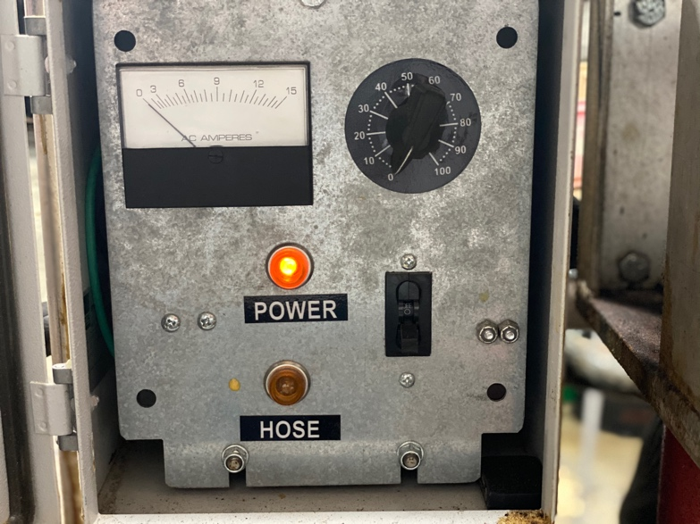
Short-Term Shutdown Checklist (overnight/lunch break)
Turn off hose heat.
1

Slide 38
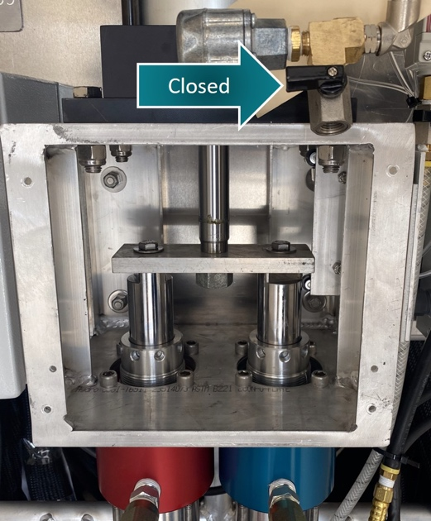
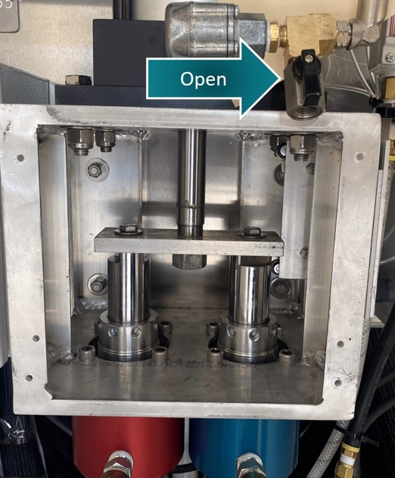
Short-Term Shutdown Checklist (overnight/lunch break)
Closed
Turn off generator.
2
Back air pressure off to 20lbs.
3
Open
In a safe direction, dispense excess material until both A and B gauges reach. approximately 200 psi.
4
Open shut down valve by a quarter turn.
5

Slide 39
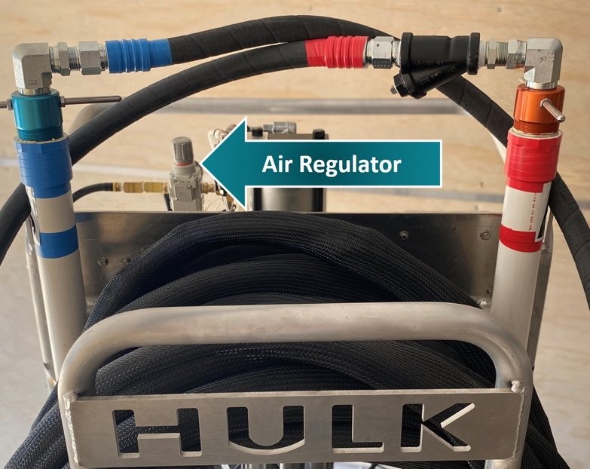
Short-Term Shutdown Checklist (overnight/lunch break)
Raise air pressure until blow off is complete.
6
Air Regulator
Turn air regulator OFF 100%.
7

Slide 40
Short-Term Shutdown Checklist (overnight/lunch break)
Close shut down valve completely.
8
Close both manifold valves on the HULK gun.
9
Disconnect air from the spray gun.
10
Remove and discard the used static mixing tip.
11

Slide 41
Short-Term Shutdown Checklist (overnight/lunch break)
Disconnect HULK gun from the hose assembly.
12
With the fluid handle in the “open” position, clean HULK gun threads and clear fluid passages with non-chlorinated brake cleaner.
13
Shut down is now complete.
14

Slide 42
Long-Term Shutdown

Slide 43
Long-Term Shutdown Checklist (2 weeks or longer)
10 gallons of the proper pump lube from 4C’s Spray Equipment must be used for flushing the HULK.
1
Pour 2.5 gallons of pump lube into a clean 5-gallon bucket for the A-Side and repeat this step with the remaining pump lube for the B-side.
2

Slide 44
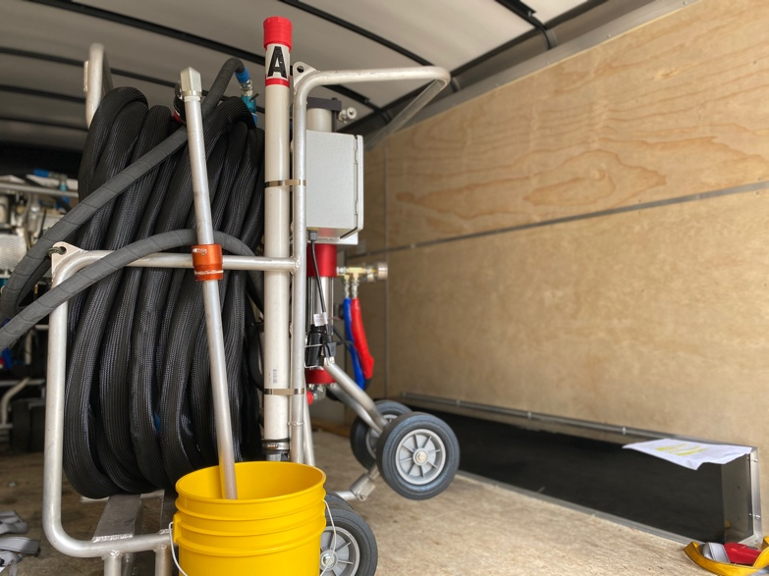
Long-Term Shutdown Checklist (2 weeks or longer)
Remove the A-Side pickup tube from the Flexible FAST drum and wipe the outside of the tube with a clean cloth before inserting into the 2.5-gallon bucket of pump lube. Ensure the tube is in a vertical position.
3
Repeat this step with the B-Side pickup tube

Slide 45
Long-Term Shutdown Checklist (2 weeks or longer)
Raise the air pressure to 20 pounds.
4
Using an empty trash receptacle, open both liquid manifold valves on the HULK gun and begin dispensing until clear liquid comes out of both A- and B-side on the HULK gun.
5
Ensure buckets of pump lube do not run empty during flushing.
6
After about 50 strokes or when clear liquid is present, lower the air pressure to zero.
7

Slide 46
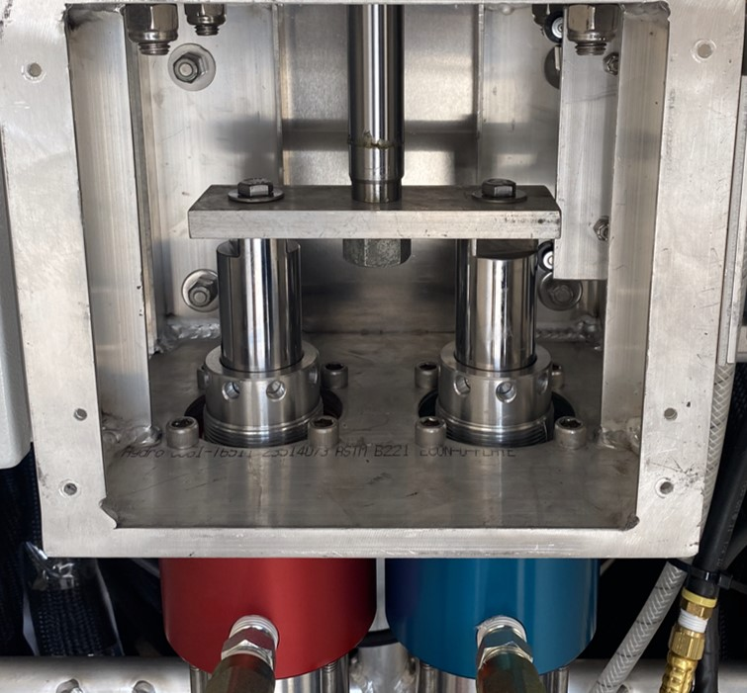
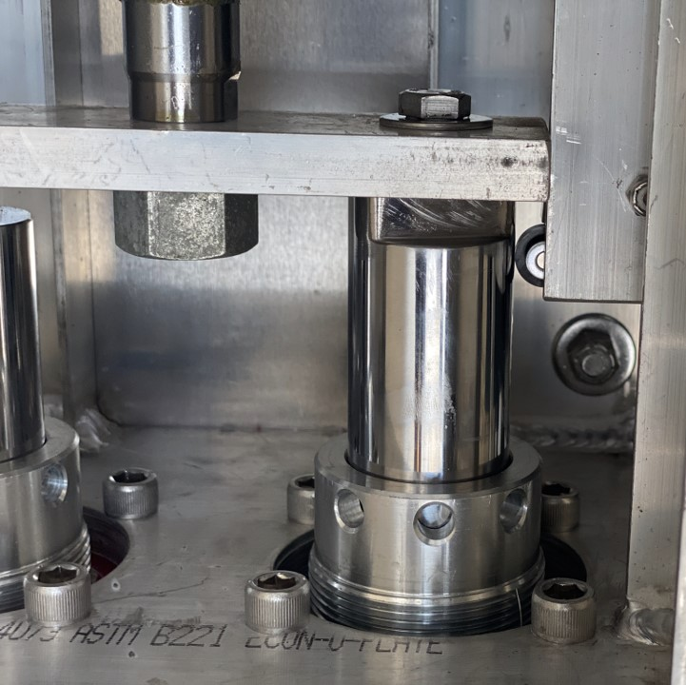
Long-Term Shutdown Checklist (2 weeks or longer)
When both sides are clear, you may put the HULK into the park position (pumps are in the DOWN position).
8

Slide 47
Long-Term Shutdown Checklist (2 weeks or longer)
Close both manifold valves.
9
Once manifold valves are closed, you must put 1 quart of CLEAN pump lube into the A-side storage tube.
Repeat this step for the B-side storage tube.
10

Slide 48
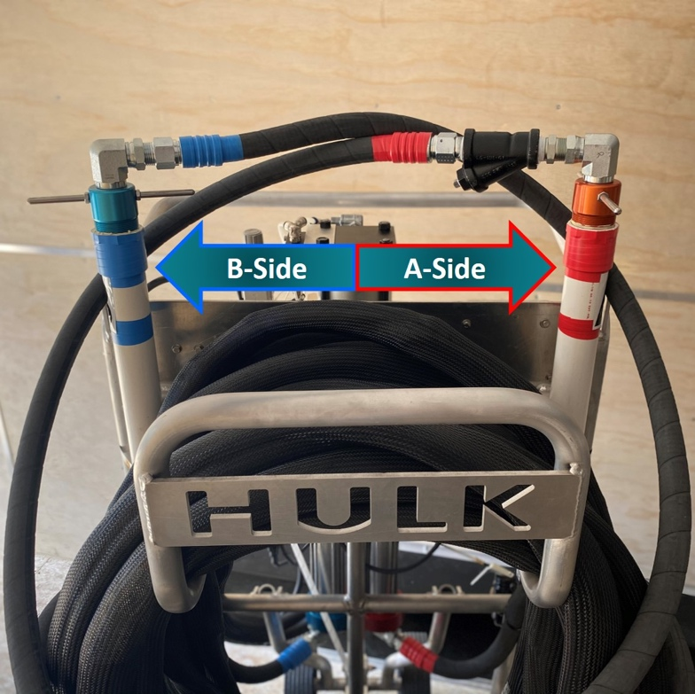
Long-Term Shutdown Checklist (2 weeks or longer)
B-Side
A-Side
Put the A-side pickup tube from the bucket of pump lube into the A-side storage tube.
Put the B-side pickup tube from the bucket of pump lube into the B-side storage tube.
11

Slide 49
Long-Term Shutdown Checklist (2 weeks or longer)
Install all bung lids on both Flexible FAST drums, making sure to use white lithium grease on the threads.
1
Disconnect HULK gun from hose assembly.
2
With the fluid handle in the “open” position, clean HULK gun threads and clear fluid passages with non-chlorinated break cleaner.
3
Shutdown is now complete.
4

Slide 50
Prevention and Troubleshooting

Slide 51
Prevention
Use white lithium grease for all fittings, and threads for static mixing tips. This helps prevent material buildup and seals all possible passages for air and moisture.
1
Letter-label or color-code fittings, desiccant driers, and containers. This helps ensure that fittings and accessories stay on their designated A- or B-side.
2
Ensure all openings have been plugged unless being vented properly.
*Replace desiccant driers when needed.
Blue = good
Pink = needs replaced
3
When in doubt, flush it out. Flushing your machine regularly will significantly increase the operating life of your HULK and reduce downtime on the jobsite.
4

Slide 52
Troubleshooting Tips
Proper storage of material is essential. Ensure the material temperature of Flexible FAST is kept at 70°F at all times.
Ensure gun & hose fittings are completely secure and tightened with no air leaks.
1
4
Ensure both ends of the desiccant driers are completely open.
Ensure hoses are free of all kinks and twists.
2
5
Ensure the Y-Screen on the A-side is clear and free of debris or crystals.
Replace if needed.
Ensure a new static mixing tip is being used after stopping for 30 seconds or longer.
3
6

Slide 53
Adhesive Cost Savings with the HULK

Slide 54
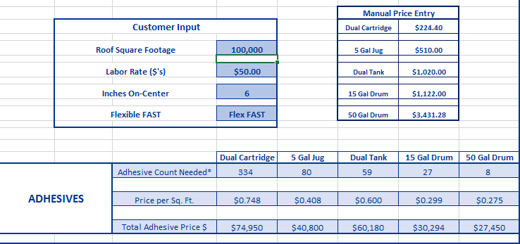

Slide 55
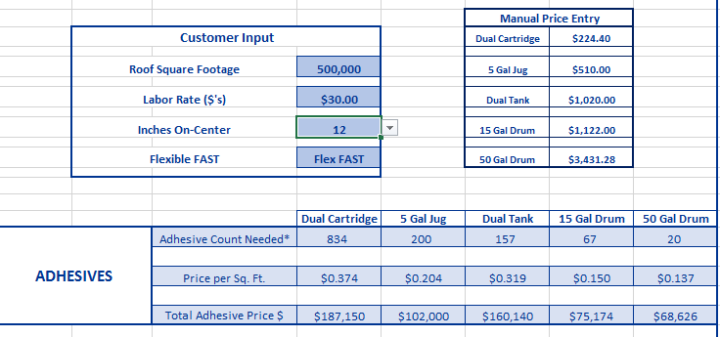

Slide 57
Questions?

